Slide 1
Trip Organiser’s Workshop
Notes:
Welcome – this is INTERACTIVE… looking for your input and questions as we go..

Slide 2
Agenda
– types of trip to consider – what makes a good club trip – organising equipment, what you need – what skills (people) you need on the trip to make it work – who in the club to approach to support your trips – how to organise trips to reduce or remove the risk of losing deposits or booking fees – challenges you may face and how to overcome them – a template “good” trip and how it worked – the “easy” option – Hardboat and Liveaboard trips and how they work – Trips aboard – options and how to go about it.

Slide 3
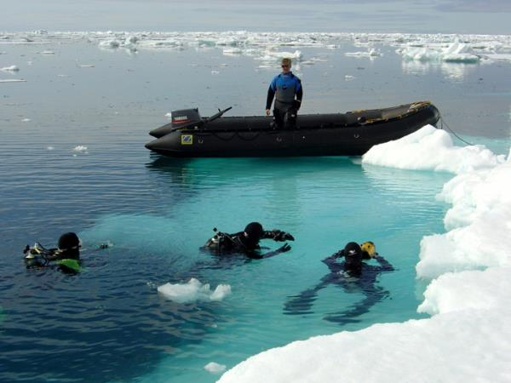
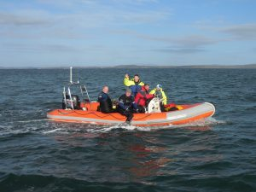
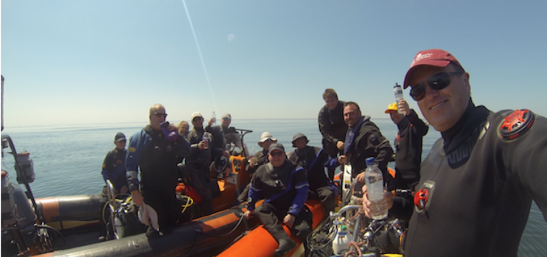
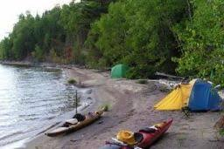
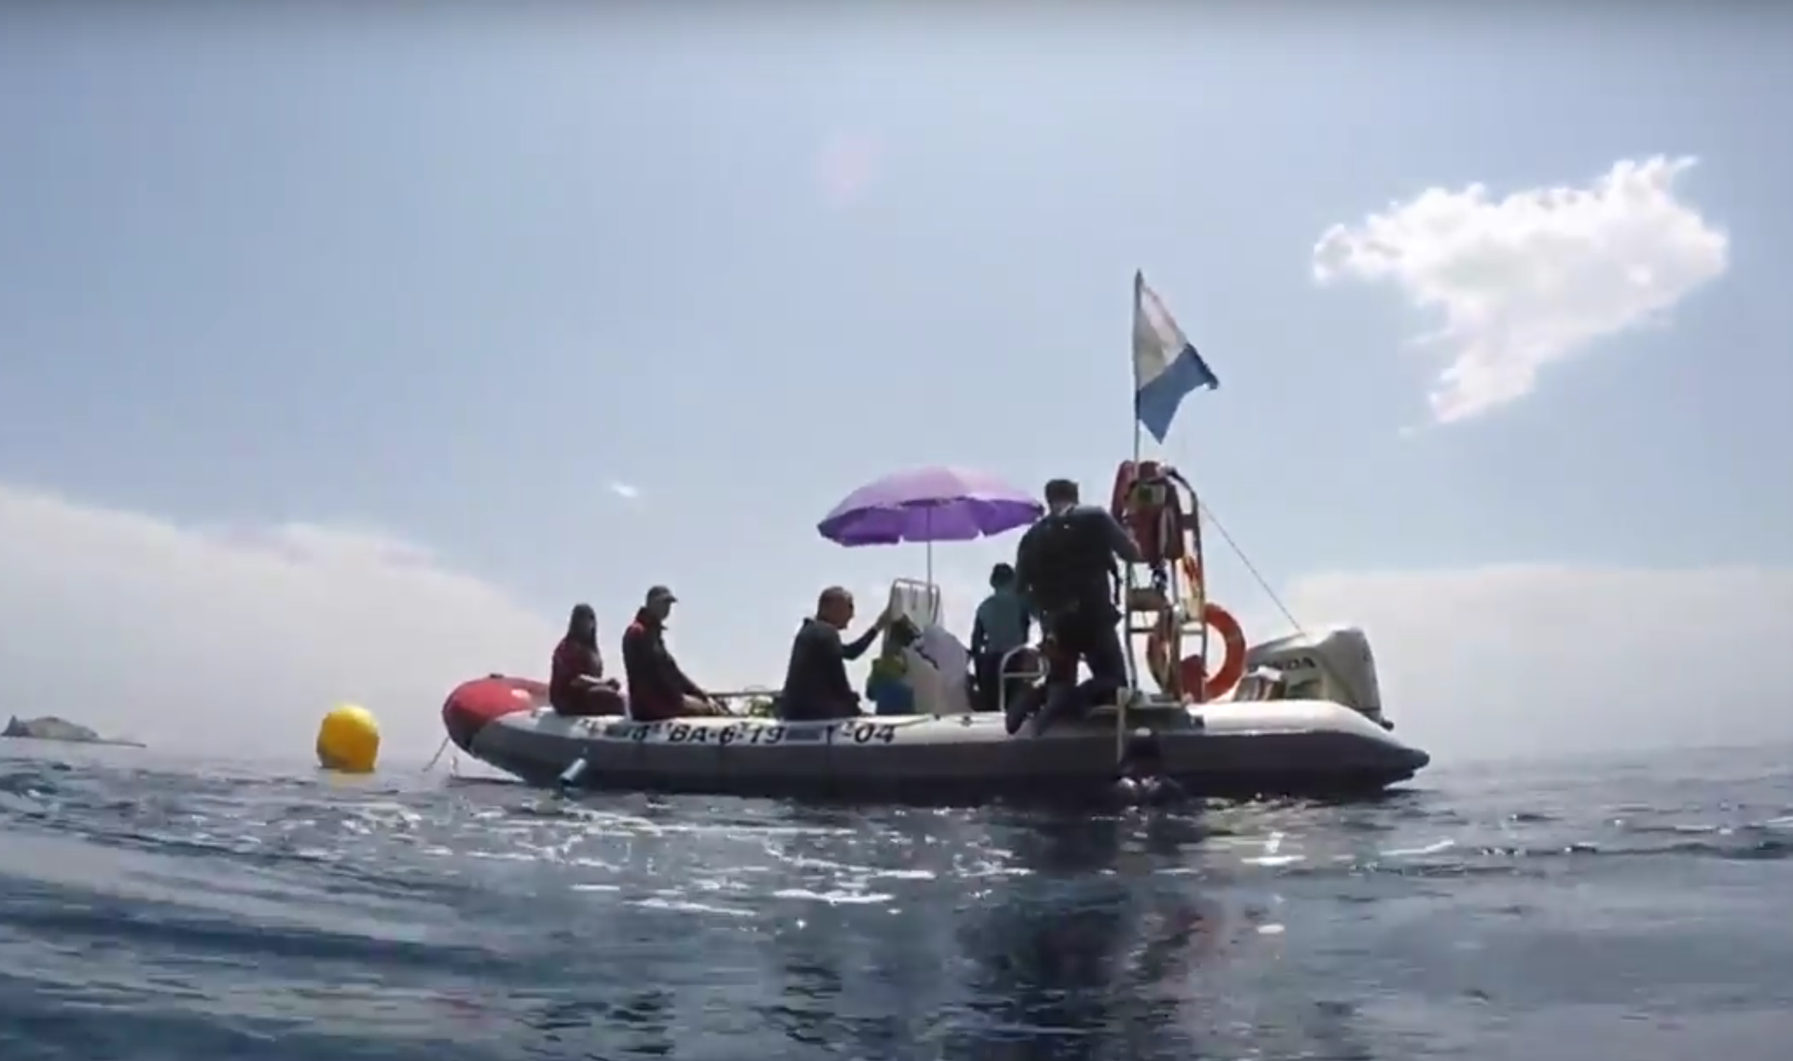
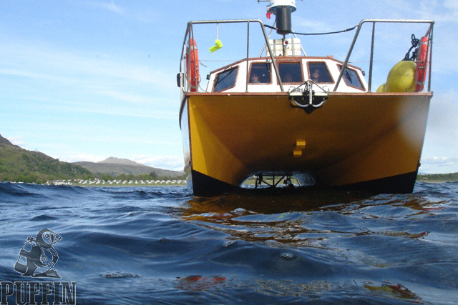
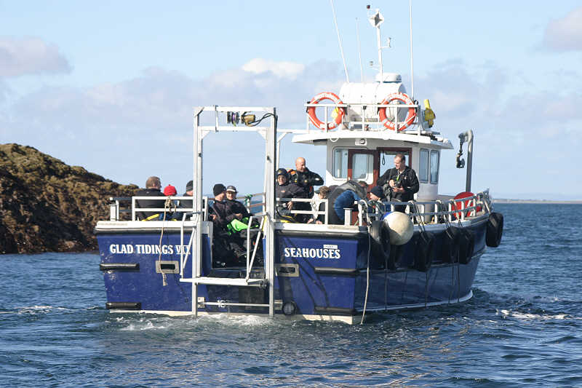
Types of trip to consider…include..
Hardest
Expedition Diving off-grid
Expedition Diving with creature comforts
Day Out
RIB Diving
Shore Diving
Weekend/Week RIB Diving
Fully Skippered Hardboat diving
Hardboat Charter
RIB Diving Abroad
Liveaboard
Easiest
Notes:
General rule = start at he bottom and work your way up..

Slide 4
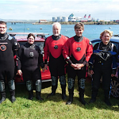
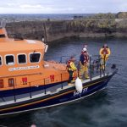
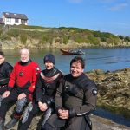
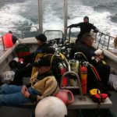
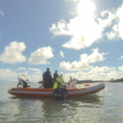
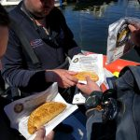
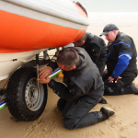
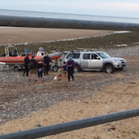
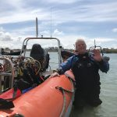
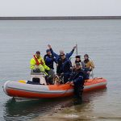
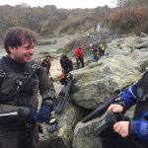
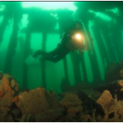
What makes a good club trip..?

Slide 5
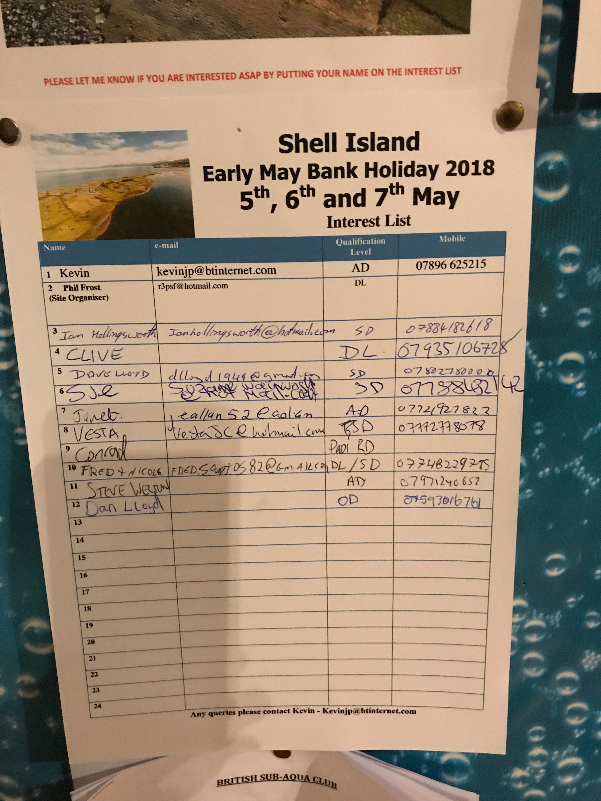
Talk to people around the club
Get some ideas
Consider putting up an interest list (gauge the interest)
Shameless Plug…

Slide 6
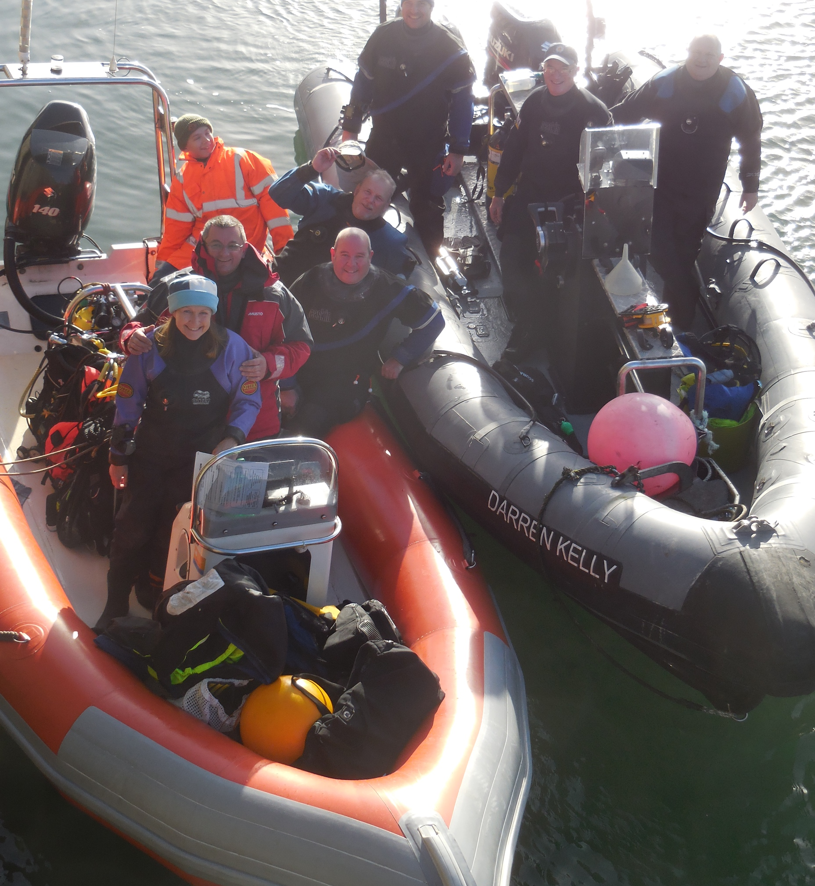
So where do you start?
Decide where you want to go…. and when.
Think about
Weather, temperature, visibility, who else will be interested
Cost
Tides
Logistics
How much work do you want to do?
Accomodation
Dive Planning
Equipment
Travel
Risks / potential for costs / accidents

Slide 8
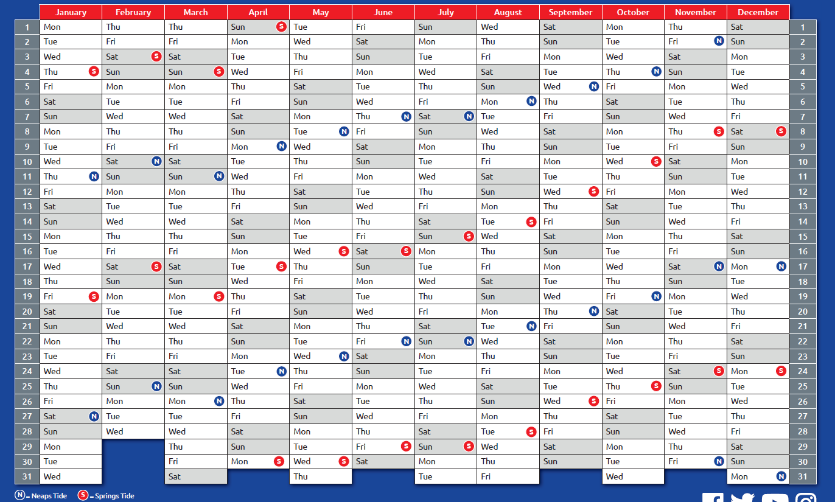
Hardboat Trips
Trip Workshop
Pool Rescue
East-bourne
Scillies Trip
MALTA
Sound of Mull
Club RIB Trips
Shell Island
Bank Hol
AGM
Events of Note
Highball Trip
Awards Dinner
Farne Islands
Rebreather Try Dive
NAS Course
PIE Prep
Dorset
Ship
wrecks
North Rona and Sula Sgeir in the North Scotland
Xmas Partry
Narvik Norway
NAS Talk
Menai Run
Weekend
Pembrokeshire
Burns Night
Xmas
MALTA
Sound of Mull
Theatre Night
Scillies Trip
East-bourne

Slide 9
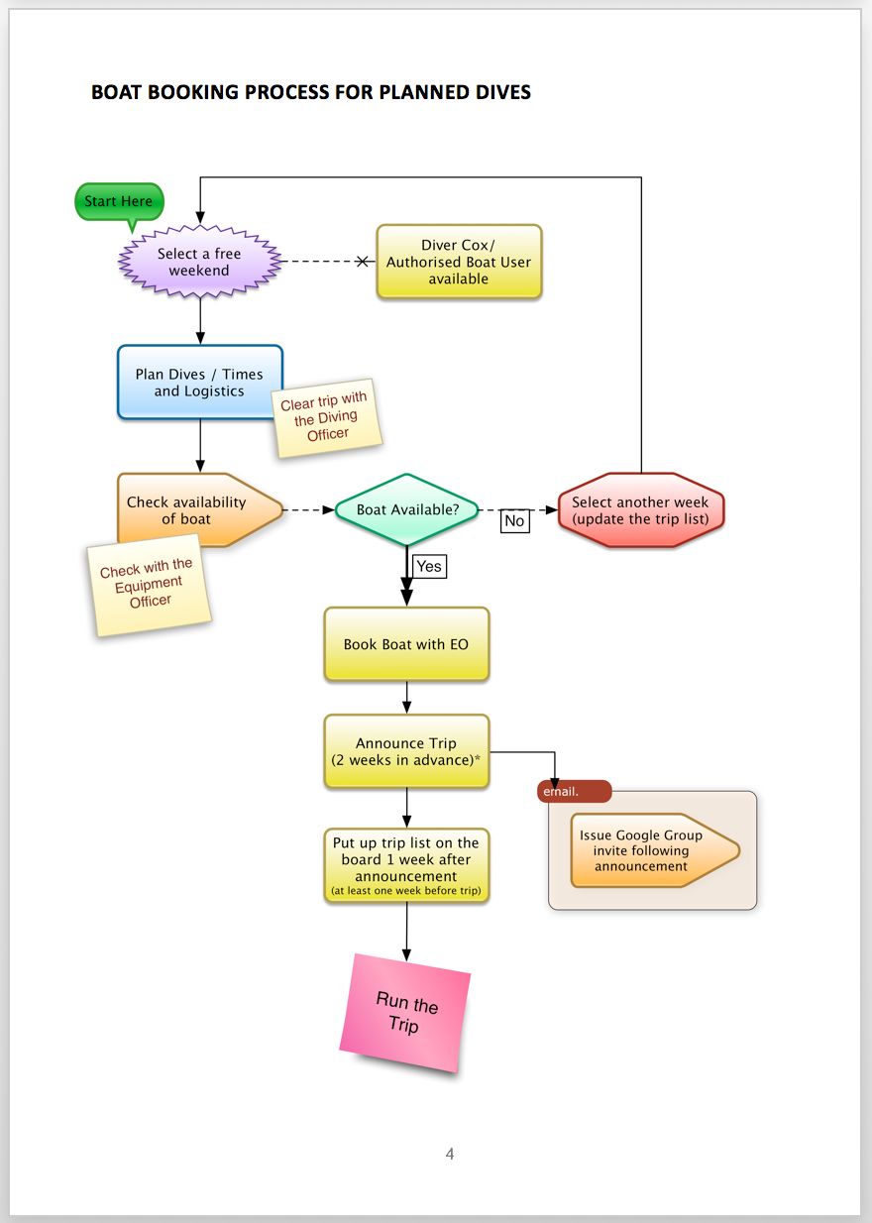
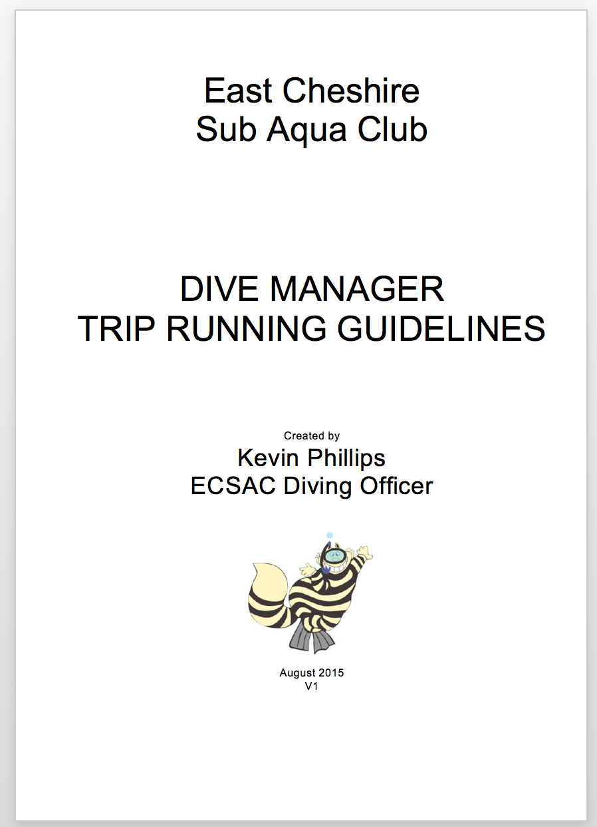
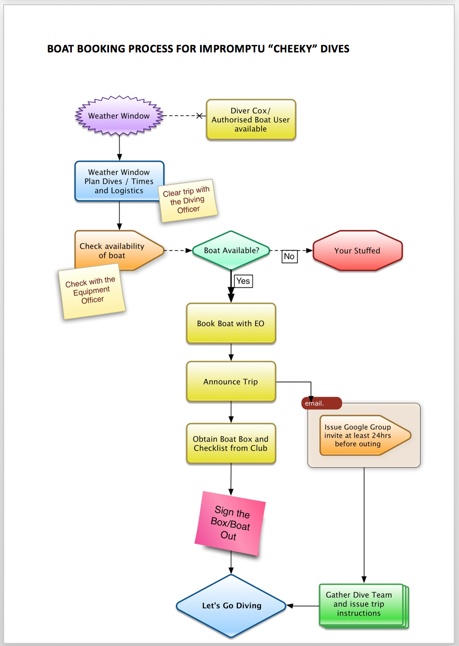
The Club Process

Slide 10
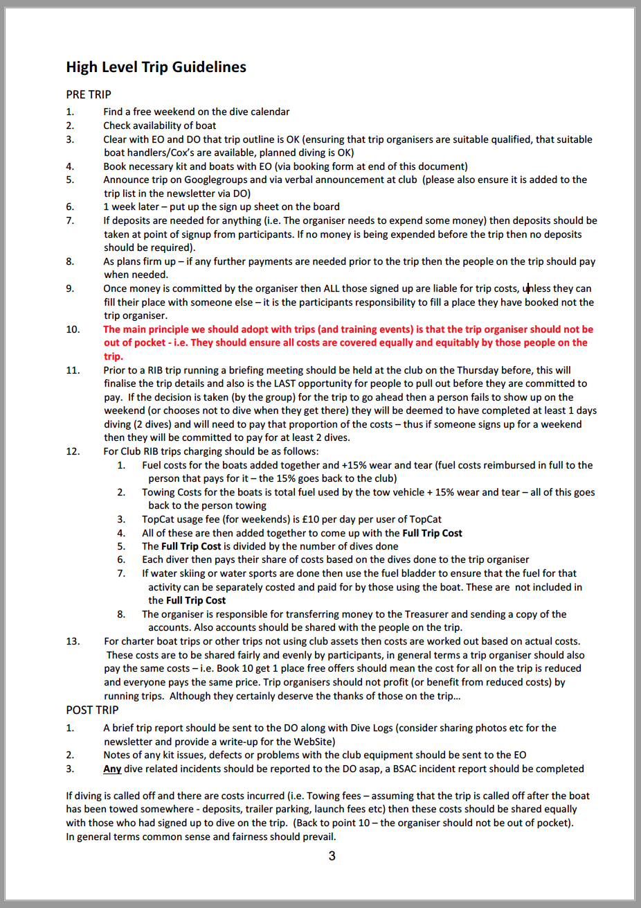
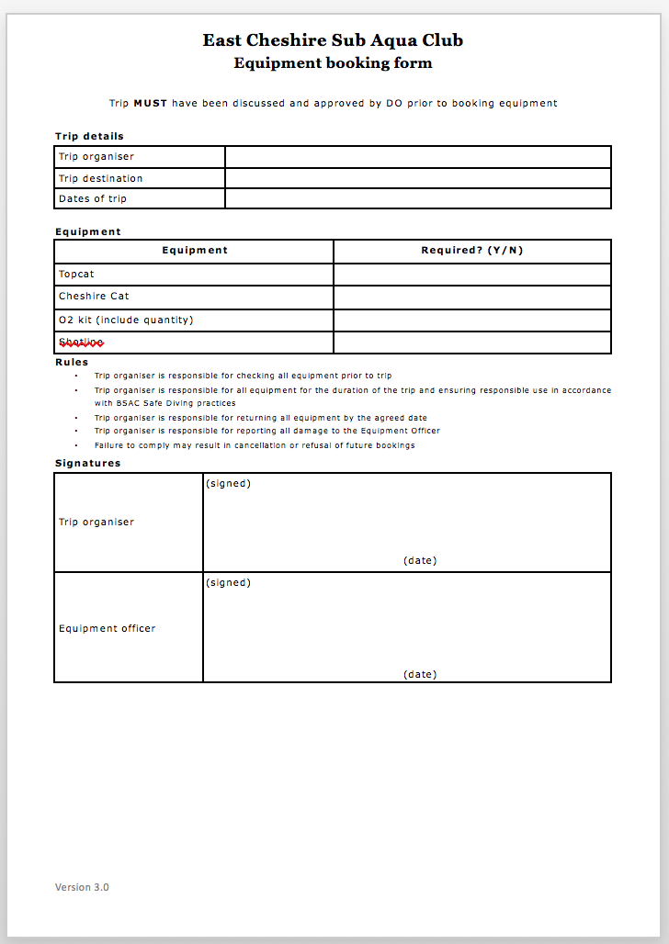

Slide 11
What about the easier trips..
Fully Skippered Hardboat diving
Hardboat Charter
Liveaboard
Easiest

Slide 12
The easier trips..
Less for you to do in terms of equipment, dive management and logistics
No overhead in terms of kit etc
Costs are fixed
Less to go wrong
Relies on Skipper’s expertise
Just turn up and dive
Need to book well in advance
Dive planning reduced (removed)
Can be more costly
Less flexible
Need to manage more money
Accommodation usually required
Mainly further afield
Fully Skippered Hardboat diving
Hardboat Charter
Liveaboard

Slide 13
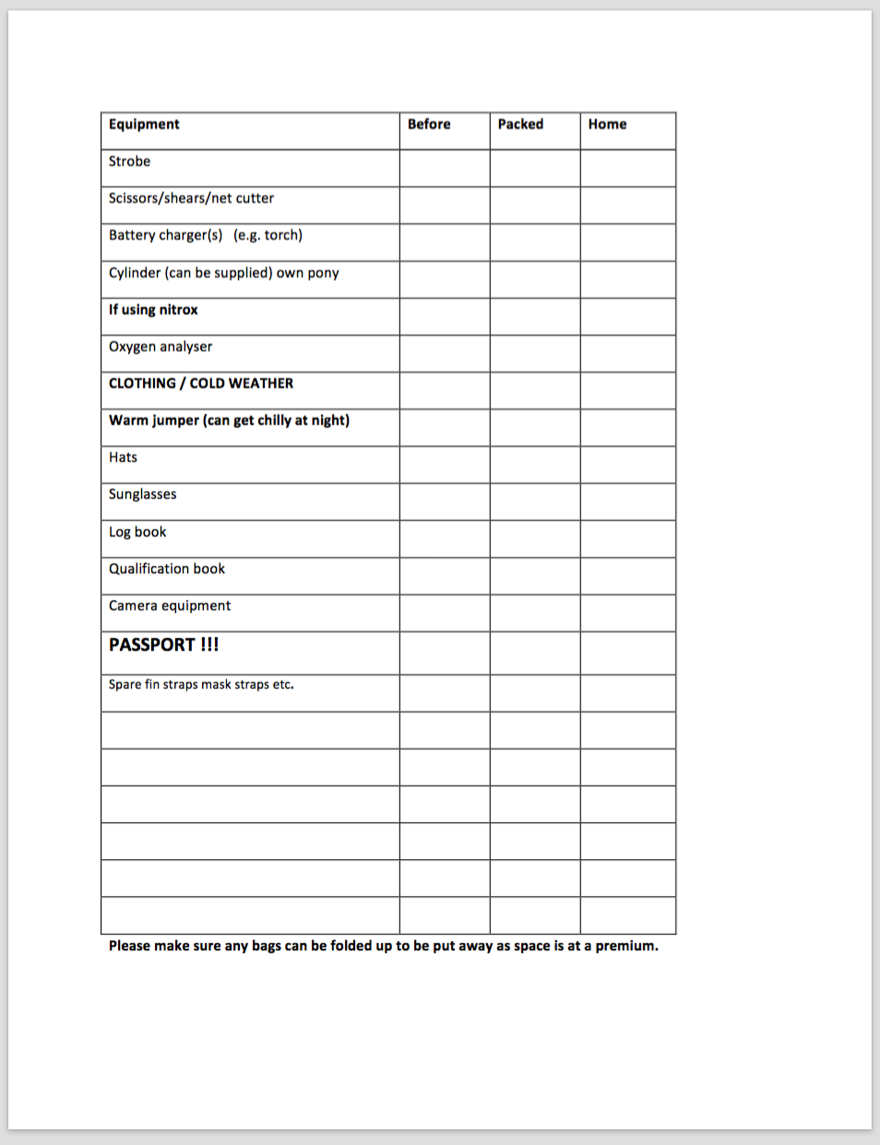
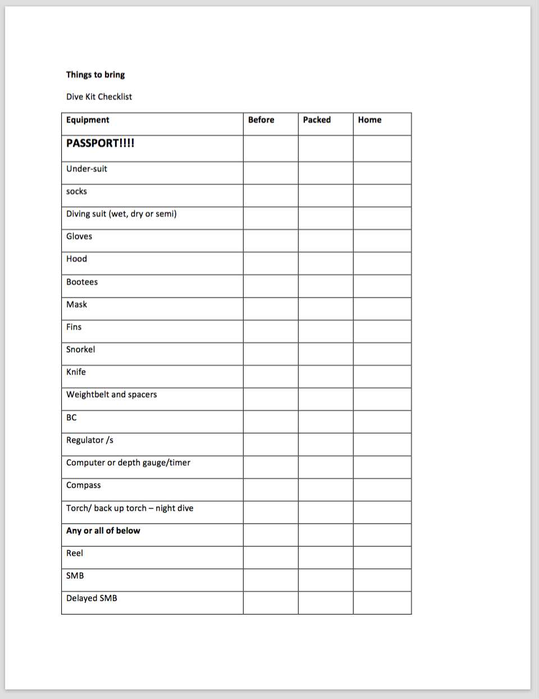
Checklists for kit and provisions

Slide 14
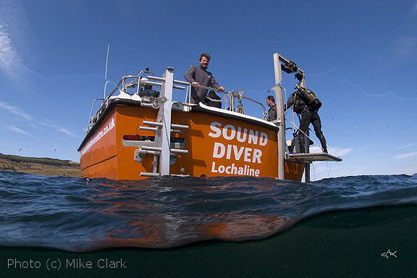
Lots of Options…

Slide 15
The easier trips.. What you need to do.
Do your research
Decide on location (take advice if needed).
Ensure the timing is right (weather, viz, events, best time for wildlife etc)
Work out deposits and ensure you have commitment before you commit
If accommodation is needed, offer options, suggest people arrange their own
B&B
Bunkhouse
Don’t take financial risks
Obtain deposits before spending
Be clear on cancellation terms
Collect money early
Fully Skippered Hardboat diving
Hardboat Charter
Liveaboard

Slide 16
A little more to think about..
Hardest
Day Out
RIB Diving
Shore Diving
Weekend/Week RIB Diving
RIB Diving Abroad
Easiest

Slide 17
Trips that need a little more effort..
Using club boats needs more organisation
You need towing vehicles, boat handlers and diver coxwains
Dive management will be more involved
Launching and recovery needs to be organised considered
We need to take the O2 kits and tools, AED etc
Detailed dive planning will be needed
Best to put together a flyer with details
Self sufficiency needed
These trips are usually good value
Less costly than hardboats
More control over where you go
More flexible in terms of options
Can have more issues (breakdowns)
More kit needed
Weekend RIB Diving
RIB Diving Abroad
Day Out
RIB Diving

Slide 18
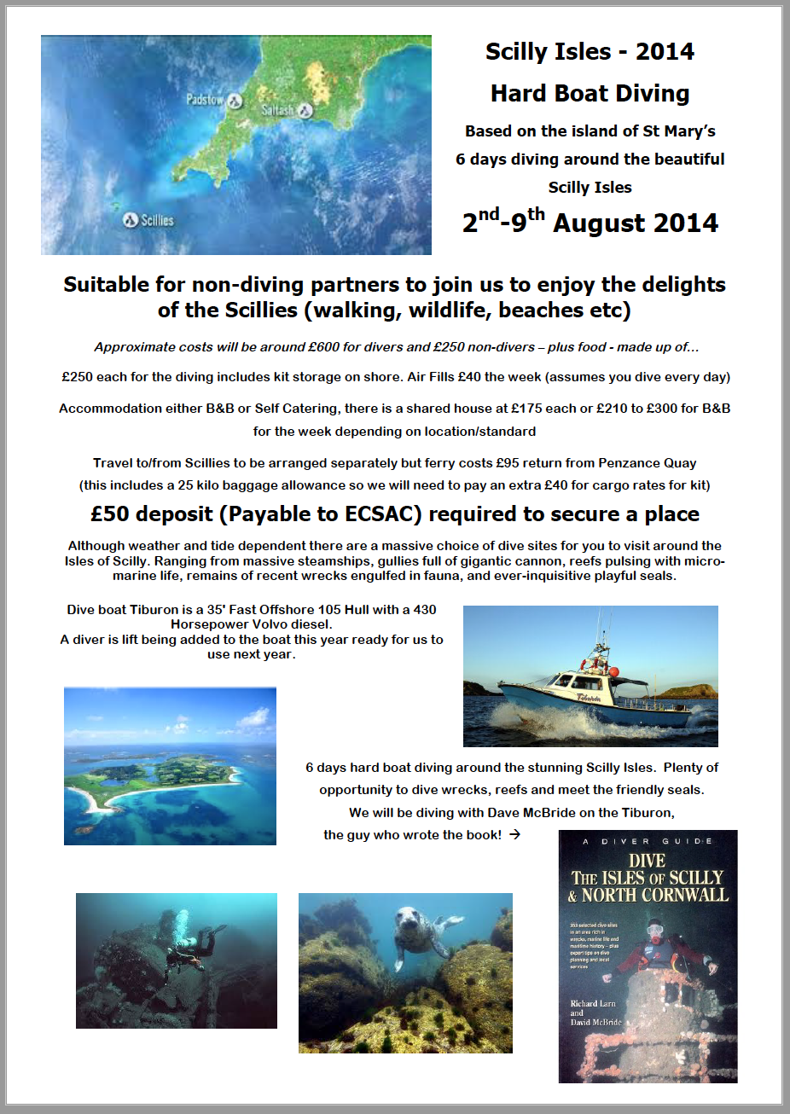
Flyers work.. Get it in the newsletter, send a google group, announce at the club, talk to people

Slide 19
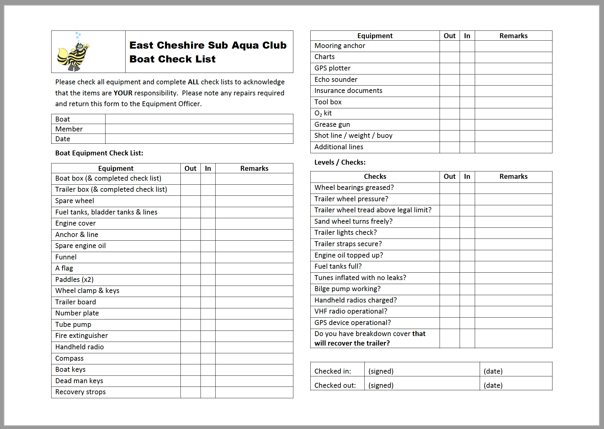
Kit Needed
+ the AED

Slide 20
Costing up a Club RIB Trip
Simples… basic rule of thumb – everyone pays the same..
Towing fuel + 15% goes to the towing vehicle
Boat Fuel (back to the person that filled it) +15% to the club
(Boats leave the boathouse full of fuel and come back full)
Mooring, Launching Fees paid by the trip
Any trip related breakages (not wear and tear) should be covered by the trip.
Add this all up and divide by the number of dives. Each diver pays for their dives (but a minimum of two)

Slide 21
Costing up a Club RIB Trip
Simples…
Towing fuel + 15% - Anglesey around £60 + 15% = £69
Boat Fuel (back to the person that filled it) +15% to the club = £80.50
around £35 per day
Mooring, Launching Fees paid by the trip (usually free – prepaid - on Anglesey)
Add this all up = £149
and divide by the number of dives.
6 divers x 2 dives a day = 24 dives so – per dive = £6.20 4 dives = £24.83
Round it up to £25 per head.
Club gets £11 for wear and tear

Slide 22
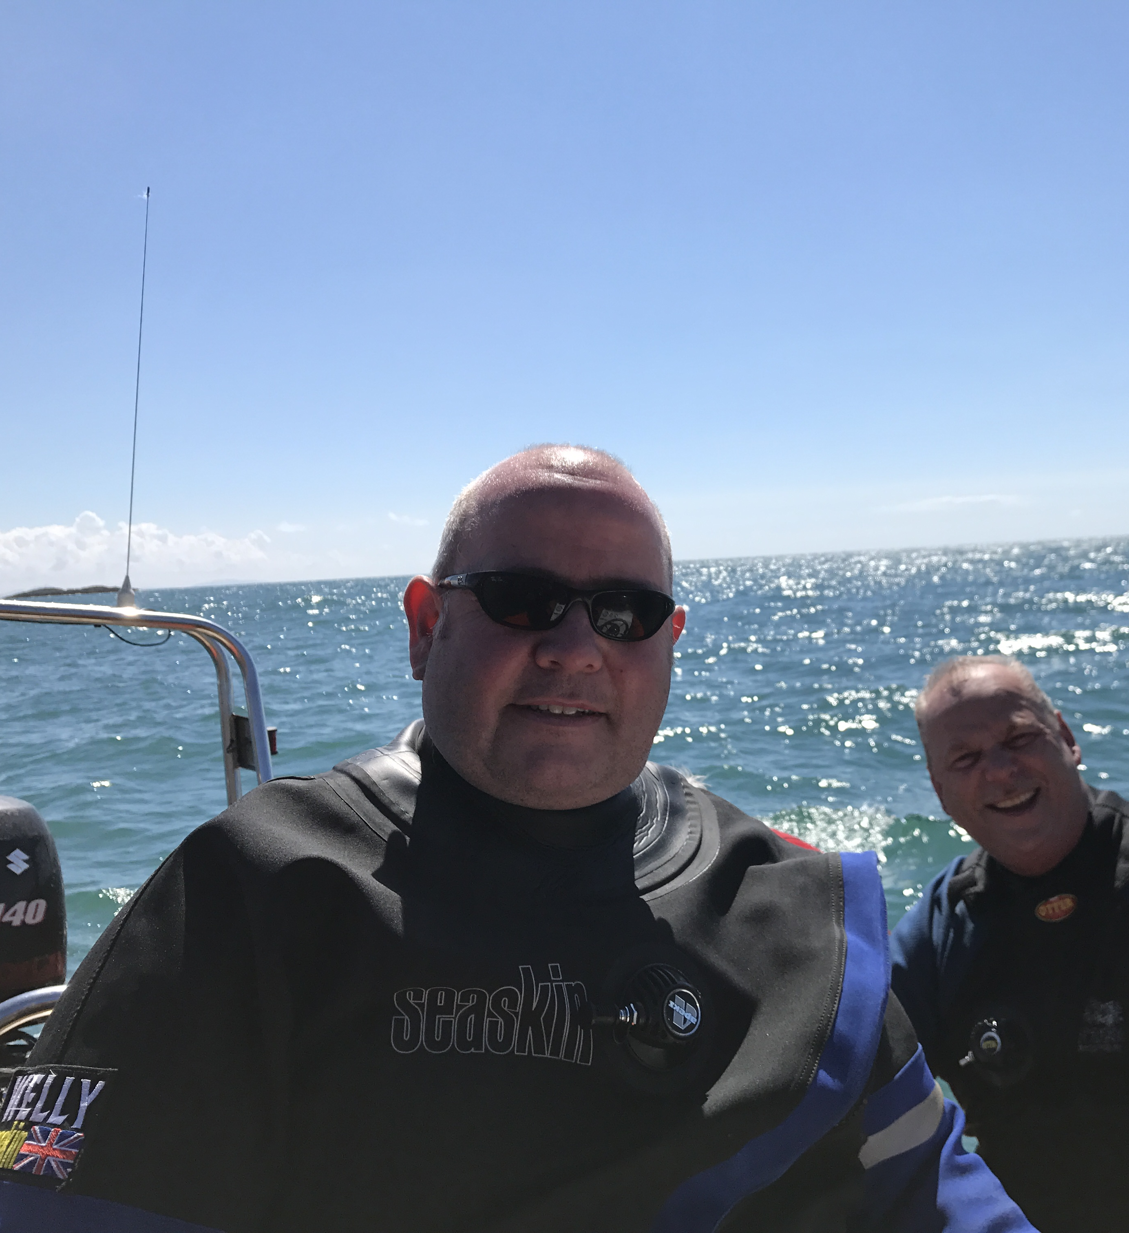
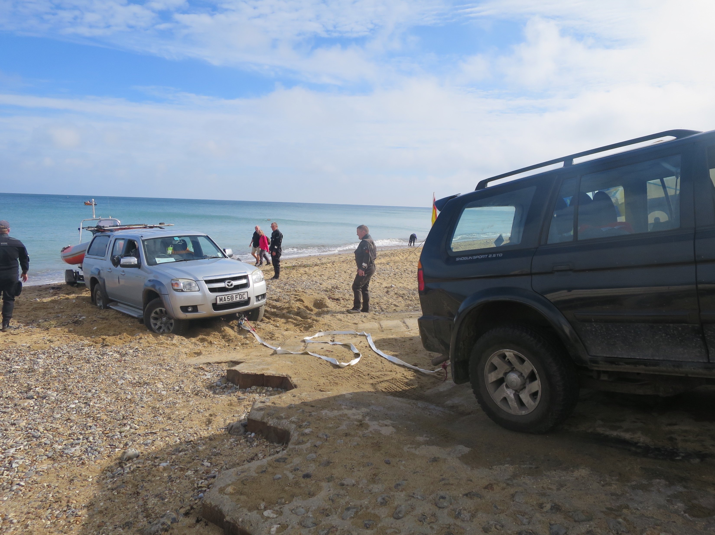
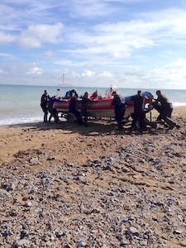
What skills (people) you need on the trip to make it work

Slide 23
Key skills include:
For RIB Trips:
Dive Managers
Tow Vehicles and drivers
Mechanics (support)
Diver Coxwains (two per boat ideally)
Key message is delegate!
Standard trips need:
Dive Marshalls, Assistant Dive Managers
First Aiders
Someone to herd the cats
Shouty people to get things moving
Cool people to keep it fun..

Slide 24
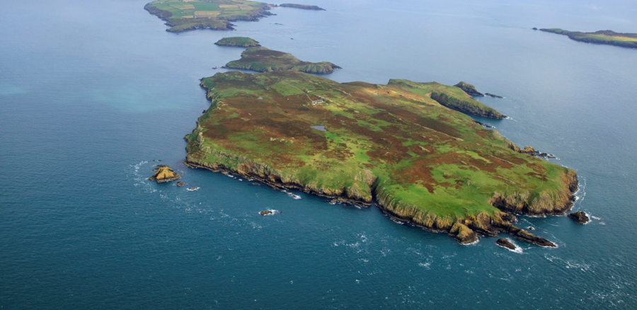
Things to think about.. How will the group get there? Where will they stay? What will they do other than diving? Any challenges in the location? Any opportunities (festivals, restaurants, trips etc)? Do you need any extra kit? What do people need to bring themselves? Breakfast Bedding Tents Extra cylinders Think about what you can organise in advance and what people need to do for themselves.

Slide 25
Types of trip to consider…include..
Hardest
Expedition Diving off-grid
Expedition Diving with creature comforts

Slide 26
Not for the fainthearted..
Lots of moving parts, usually involving distance, projects and complex logistics -
Isle of Man, Scapa etc (RIB launches, crossings and overnight mooring)
Long distances
Usually for a week or more
Project Diving
Issues with air fills and self sufficiency (compressors needed)
Wild Camping and remote areas
LOTS OF GEAR – LOTS OF FUN!
Expedition Diving off-grid
Expedition Diving with creature comforts

Slide 27
How to organise trips to reduce or remove the risk of losing deposits or booking fees
Main answer is:
Switch from an interest list to a trip list and obtain commitment (and deposits).
Get commitment early. If you need to spend money to confirm bookings then make sure you obtain trip deposits before you spend (usually best to collect a little more than you need, to cover contingency).
Ensure those on the trip list are kept informed and you check they are still committed and able to go at intervals (if there is a long lead-time).
People should know that if they commit, then they are liable for any unavoidable costs or for finding someone to fill their space.
Communicate!

Slide 28
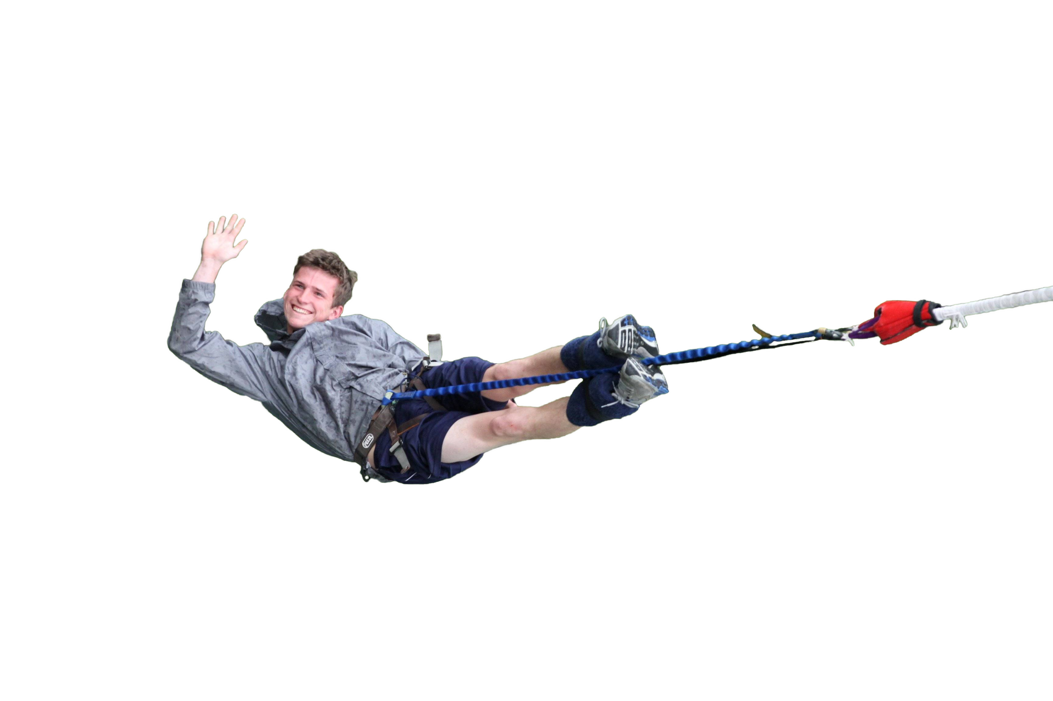
How to deal with Dropouts
Try and reduce the impact of dropouts by finalising details and collecting money early.
Ensure people know when they are committed and what they are committed to
Change from interest list to commitment early
Make sure people know it is up to them to find someone to take their place
Make sure your communication is clear and frequent
Don’t leave things to the last minute, you end up holding the baby!

Slide 29
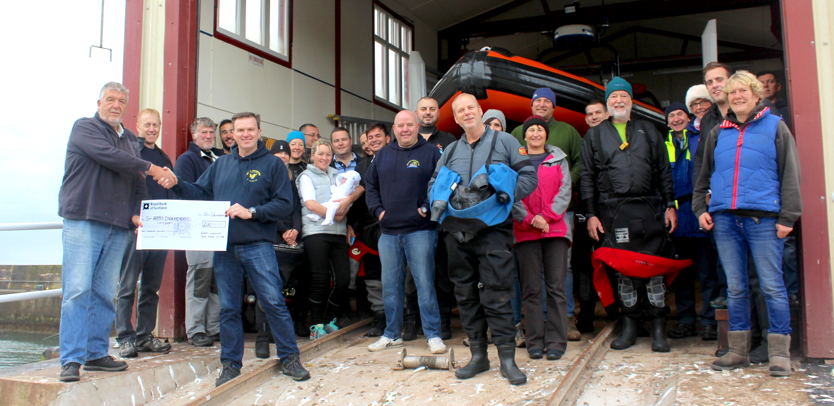
A template “good” trip and how it worked
St Abbs – 2016.. 28 people diving, 31 people for the meal.
Boat booked well in advance with flexibility for shuttles…
After booking and realising it was going to be very popular I negotiated a day charter rate not a per dive rate – reduced the cost and generated £200 for a donation to the St Abbs Lifeboat
Pre-booked accommodation for everyone – Holiday Park – Scoutscroft
Pre-Booked Saturday night Meal at restaurant (28 people).. Delegated working out the bill… :0
Diving was flexible and adaptable and people knew when they were out, while not out local cafe and quayside was a nice place to be.
People paid for the entire weekend, not by dives –
so easier to work out payment
People who dropped out close to the event had already paid..
No shortfall of funds. They lost their payments. It did not cost anyone else.
Some people dropped out early and found replacements,
so it cost them nothing.
Dive managers were delegated on the boat so it spread the load on dive logs etc.

Slide 30
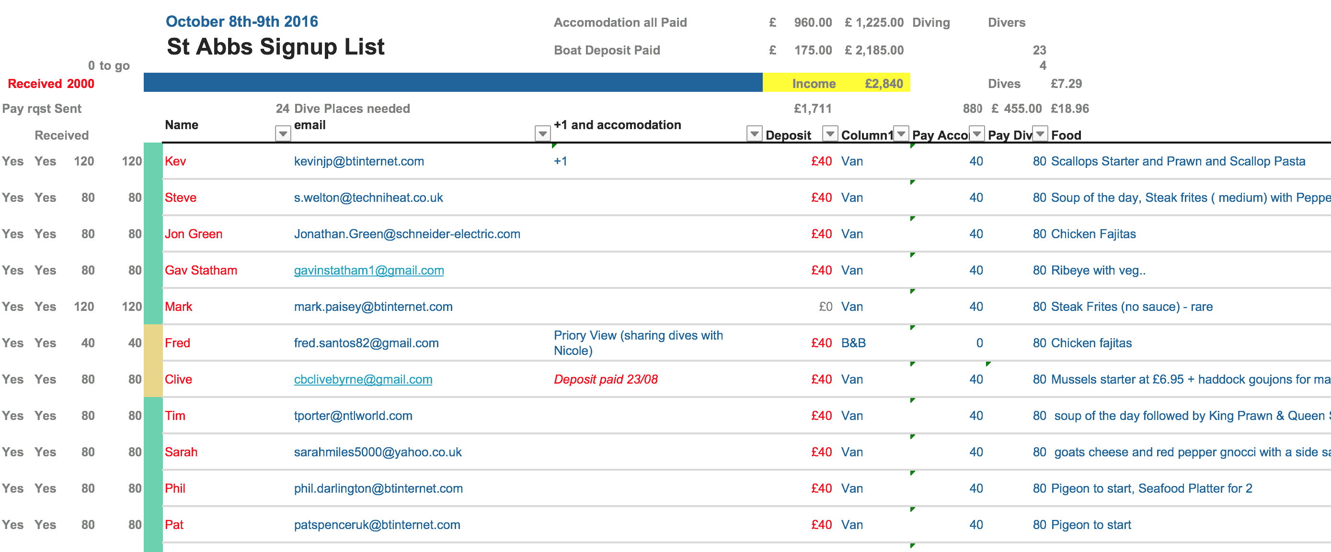
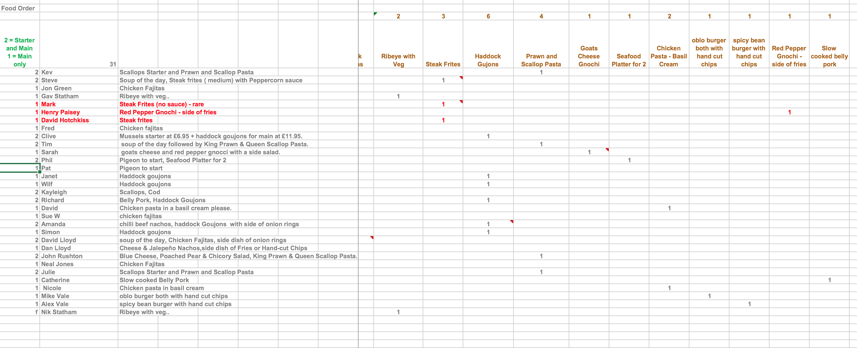
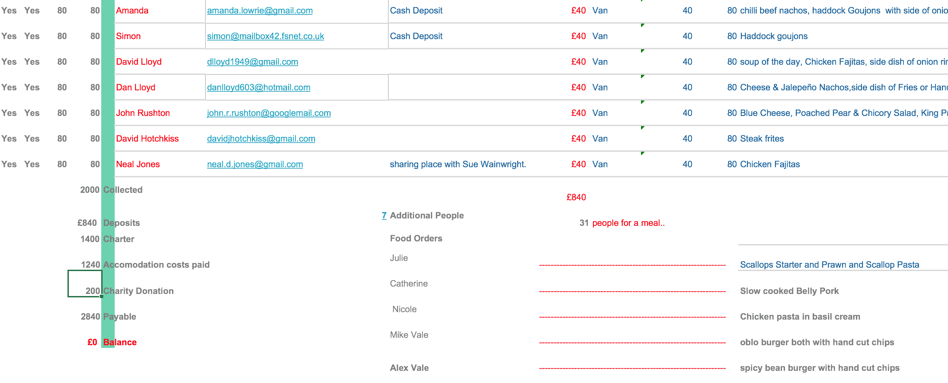

Slide 31
Did we cover everything?
– types of trip to consider – what makes a good club trip – organising equipment, what you need – what skills (people) you need on the trip to make it work – who in the club to approach to support your trips – how to organise trips to reduce or remove the risk of losing deposits or booking fees – challenges you may face and how to overcome them – a template “good” trip and how it worked – the “easy” option – Hardboat and Liveaboard trips and how they work – Trips aboard – options and how to go about it.

Slide 32
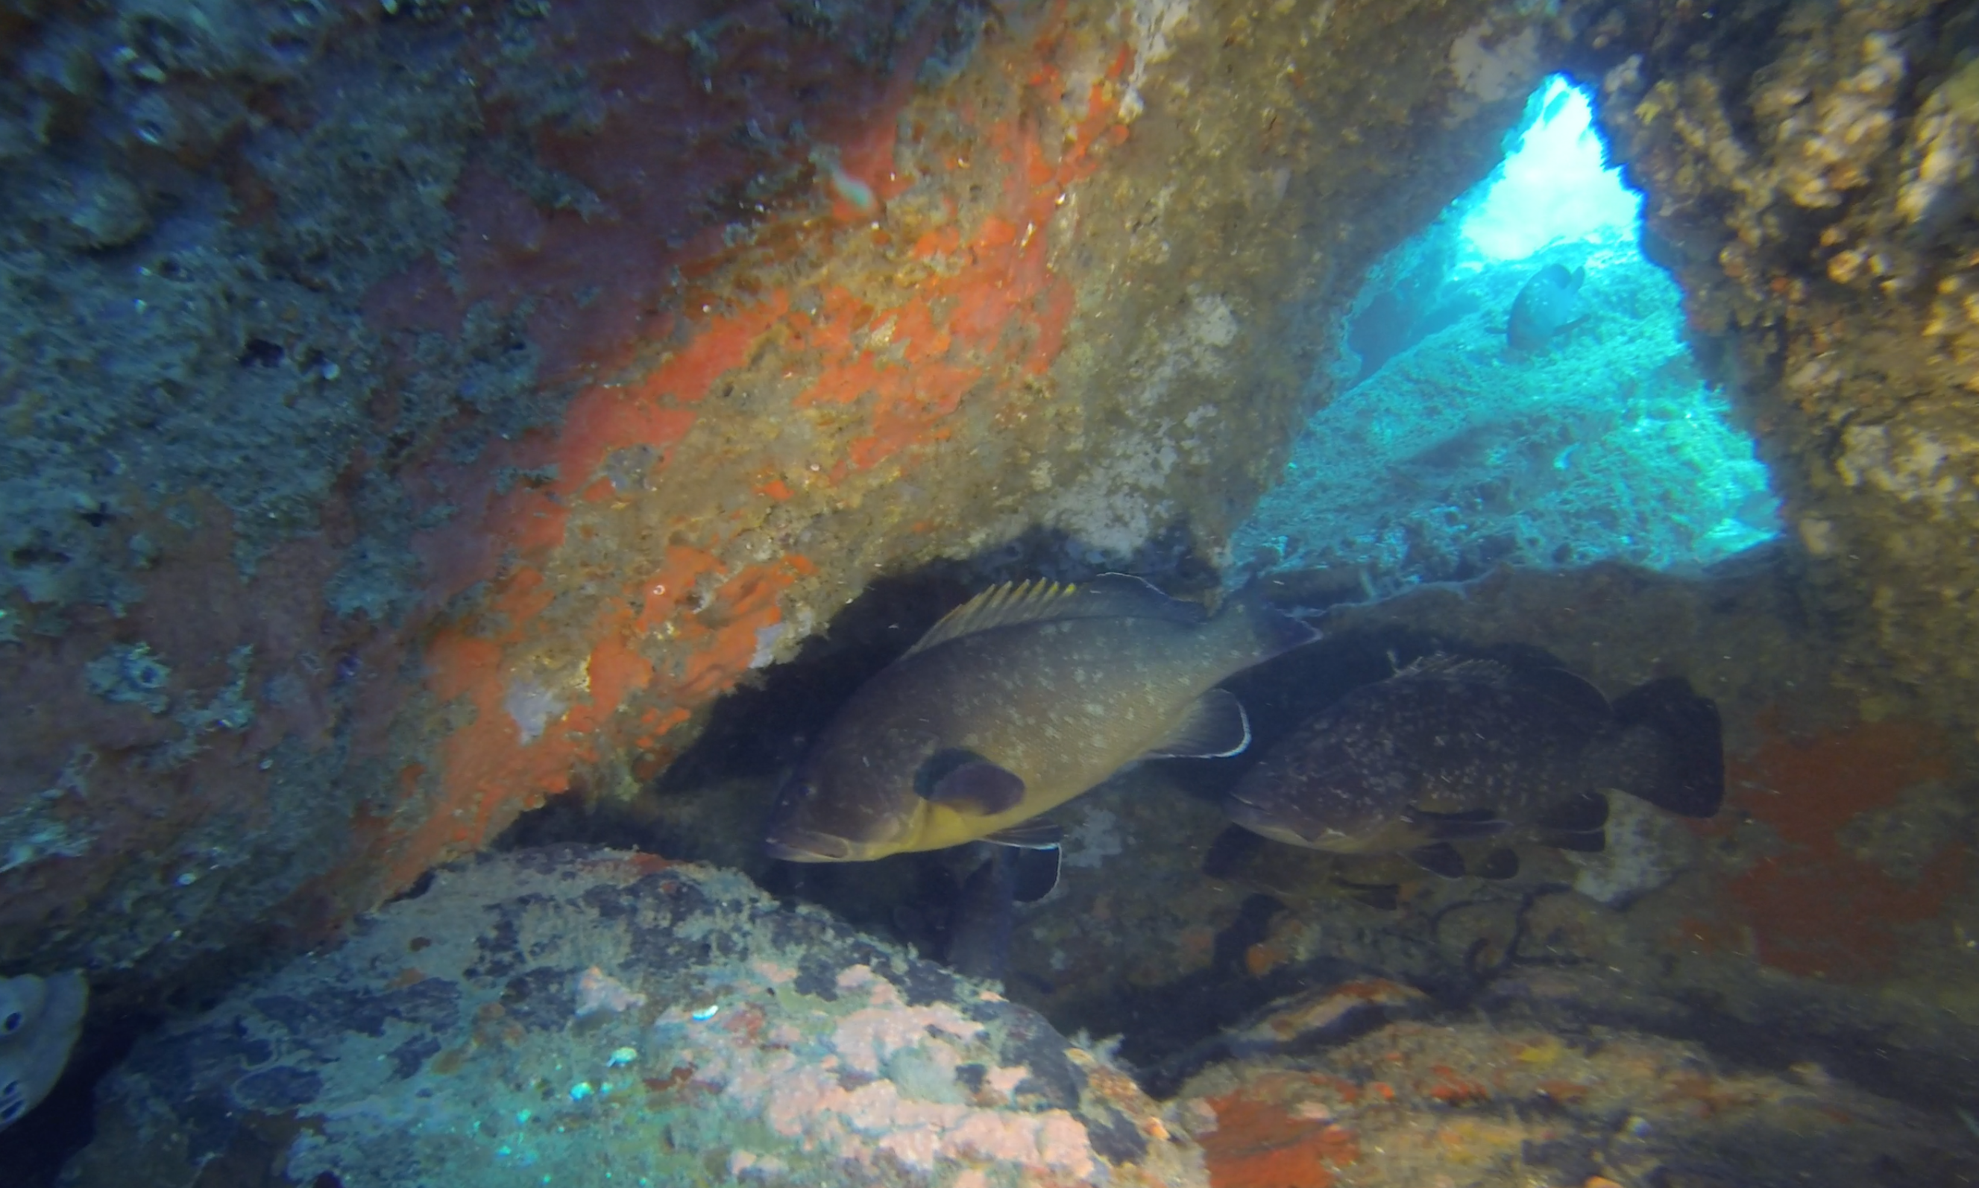
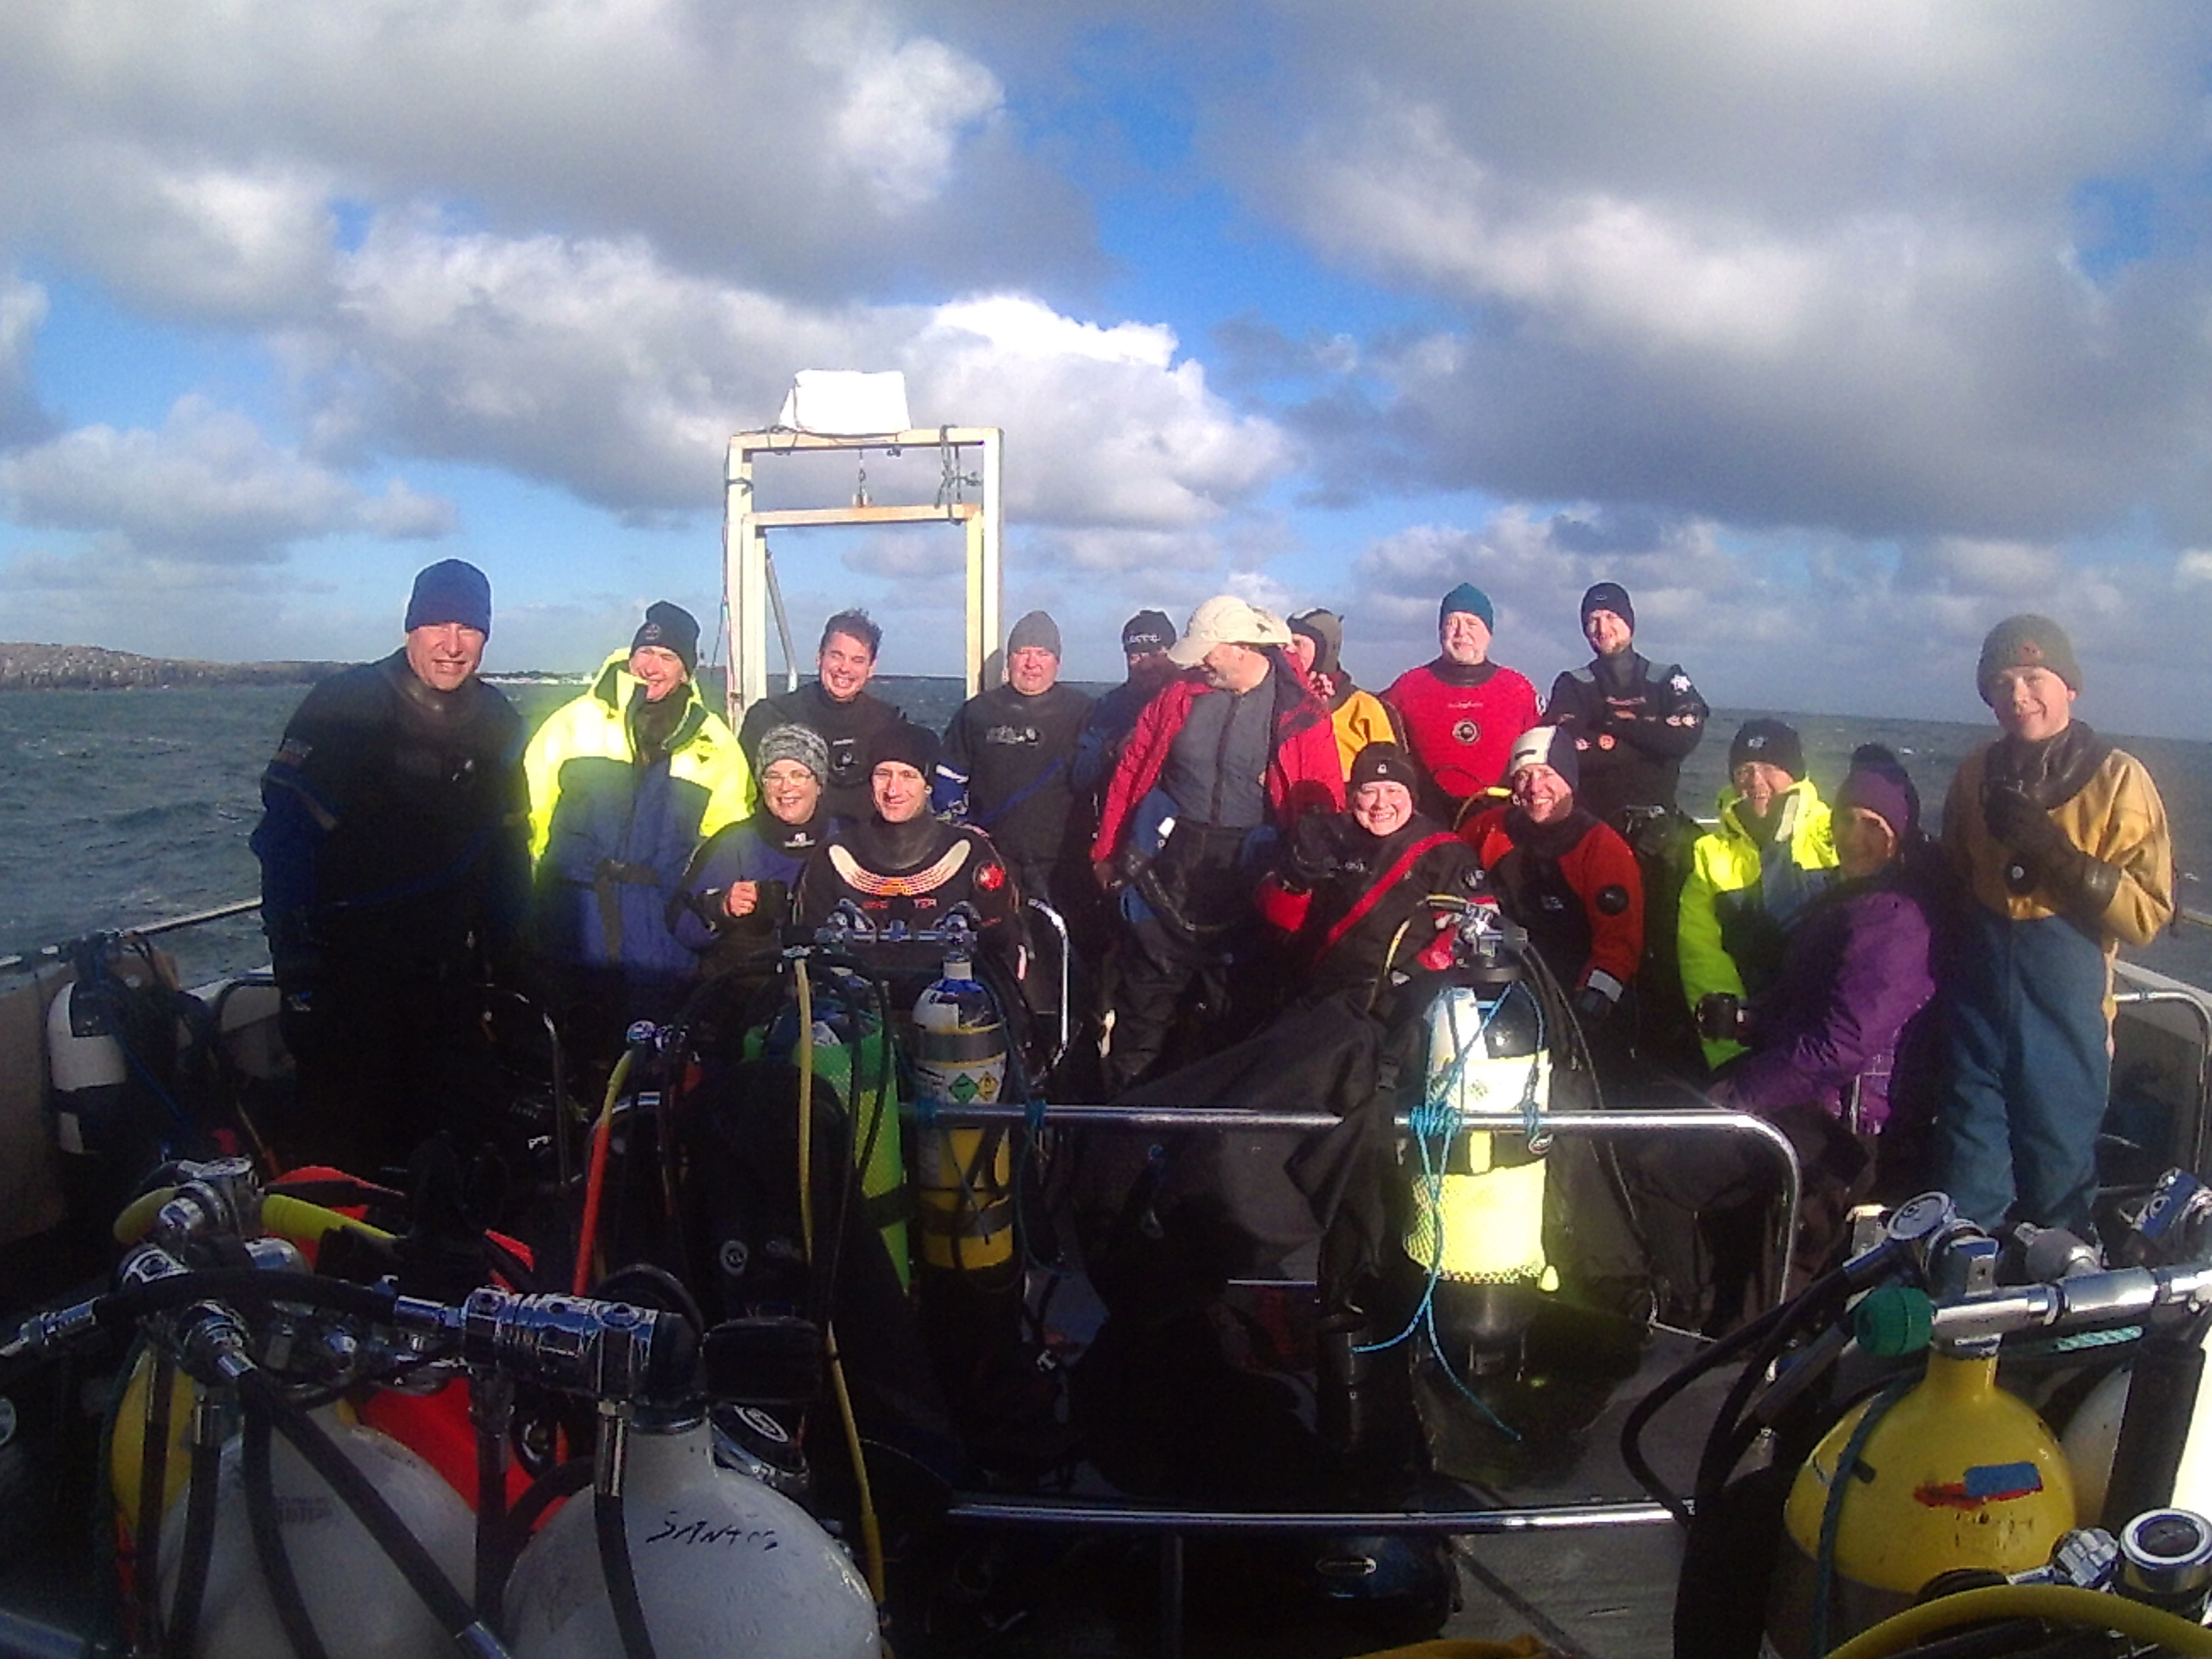
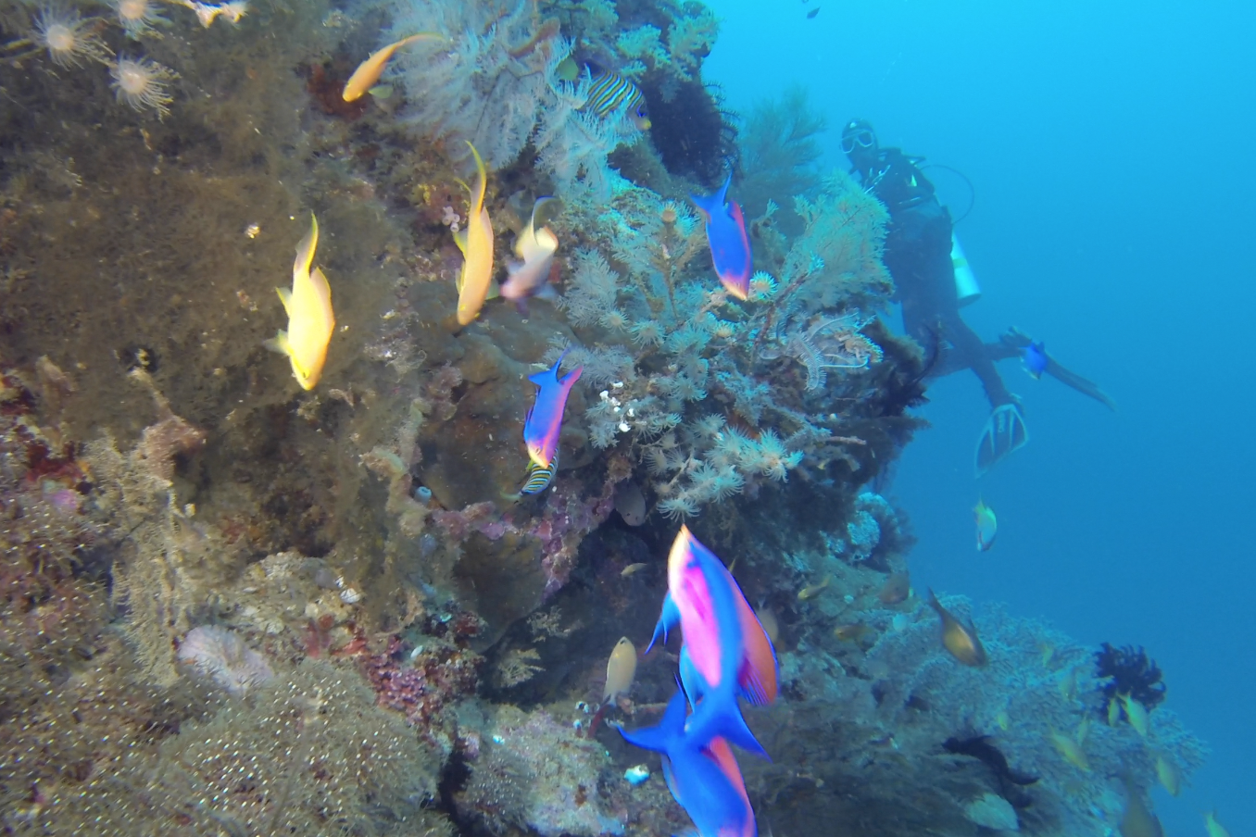
Key Messages
Talk to people
Make something happen
Run or assist on a joint trip, learn the ropes
You can find people to help with the key elements
Dive Managers
Diver Coxwains
Tow Vehicles
Or just keep it simple… let’s go diving.

