Slide 1
New Ocean diver course update

Slide 2
From BSAC: Key updates to Ocean Diver include
Greater flexibility in delivery by tracking student progress using the skills elements. The theory lessons can also be delivered via Skype (or a similar system) if face to face sessions are not always possible. Open water sessions can be delivered in a minimum of four dives or more to suit the student’s needs.
Clearer, more engaging training materials and improved instructor resources, with simplified language and improved visuals.
Updated student guide and improved tracking methods of students’ progress.
Updated performance standards for skills.
Additional teaching resources and student resources including skills videos and student quizzes.
This presentation is to help break down the new course and summaries some of the changes a little more
NB this is not exhaustive and please read the Instructor Manual

Slide 3
Outline
New branding
Course outline & qualification
Course material
Theory Lesson
Sheltered Lesson
Open water Lesson
Emphasis

Slide 4
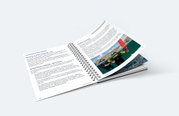
New Branding
Refreshed Visual Aids
New Ocean diver packs
Refreshed Student manual
Refreshed Instructor Manual
Refreshed Ocean diver prompts

Slide 5
Make your own slides with new powerpoint template
Go to Instructor materials on the webpage
https://www.bsac.com/page.asp?section=5100&sectionTitle=Instructor+Materials
Some stock images but you can add your own

Slide 6
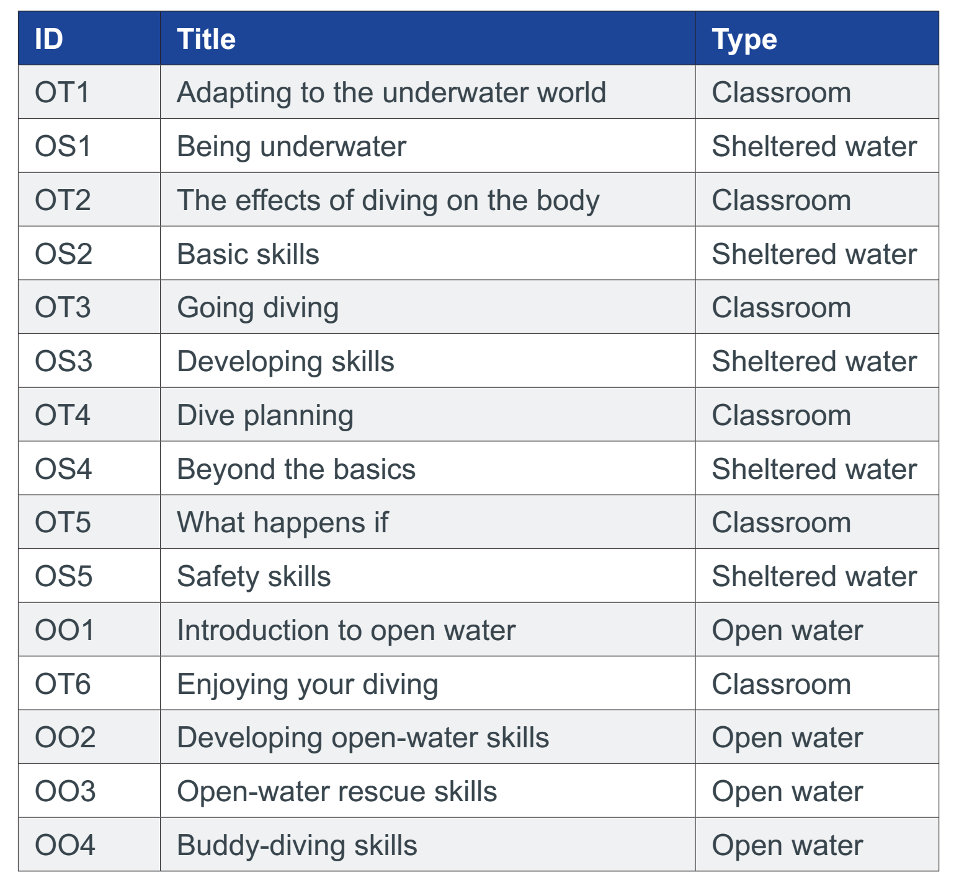
Course outline
OD Theory Module
OT1 - Adapting to the underwater world
OT2 - The body and the effects of diving
OT3 - Going diving
OT4 - Dive Planning
OT5 - What happens if?
OT6 - Enjoying your diving
Subtitle to go like this
Bulleted copy to go like this
Copy under bullet to be like this
Secondary bullets like this
Tertiary bullets like this
OD Sheltered Water Modules
OS1 - Being Underwater OS2 - Basic Skills OS3 - Developing Skills OS4 - Beyond the Basics OS5 - Safety Skills
OD Open Water Modules
OO1 - Introduction to Open Water OO2 - Developing open water skills OO3 - Open water rescue skills
OO4 - Buddy diving skills

Slide 7
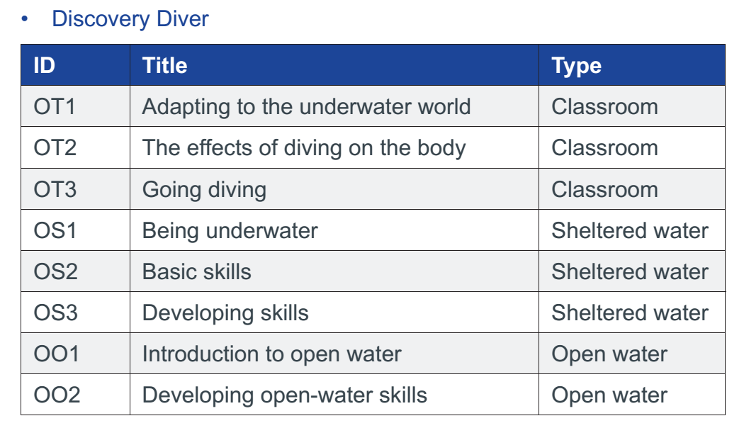
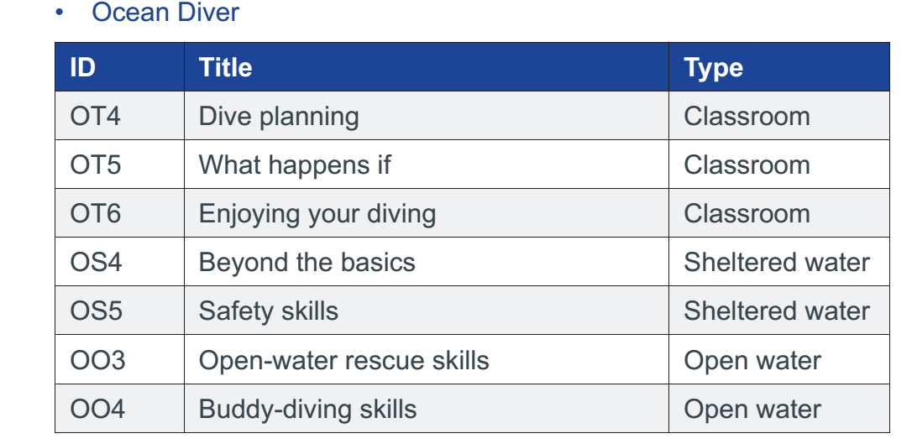
Discovery diver
The course can now be truncated to the new “discovery diver” qualification
Where the “discovery diver” is for people who potentially are can not complete the full ocean diver course.
or will need continue on the full “ocean diver” qualification later.

Slide 8
Discovery Diver is defined as a diver who is competent to conduct dives:
with a Dive Leader within the restrictions of the conditions already encountered during their training.
to a depth which is initially limited to the maximum experienced during training, but which can subsequently be extended progressively, under the supervision of a Qualified Instructor (QI), to a maximum of 12m
using breathing gas mixes of 21% O₂.
not requiring mandatory decompression stops
under the on-site supervision of a Dive Manager with respect to site selection, conditions and dive plan
where other divers, capable of providing assistance and rescue, are available at the surface
within BSAC safe diving recommendations

Slide 9
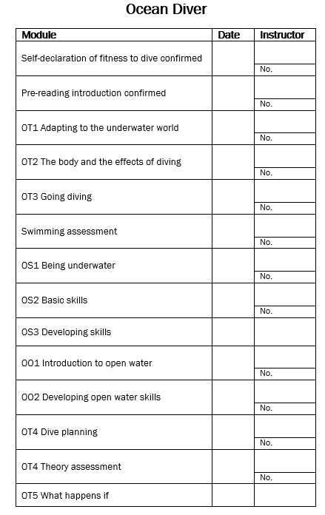
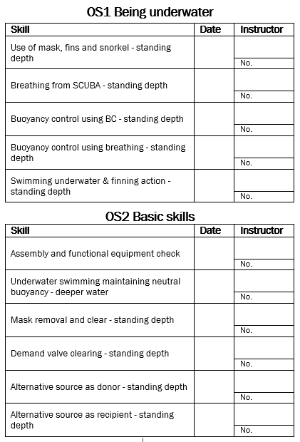
New qualification recording
Theory qualification recording the same
Pool and Open each component is signed off
This is good for the student as they get an idea of the skills that are to come and they have their own record if the move branches etc. NB The club will also have record aswell which will help with instructor preparation

Slide 10
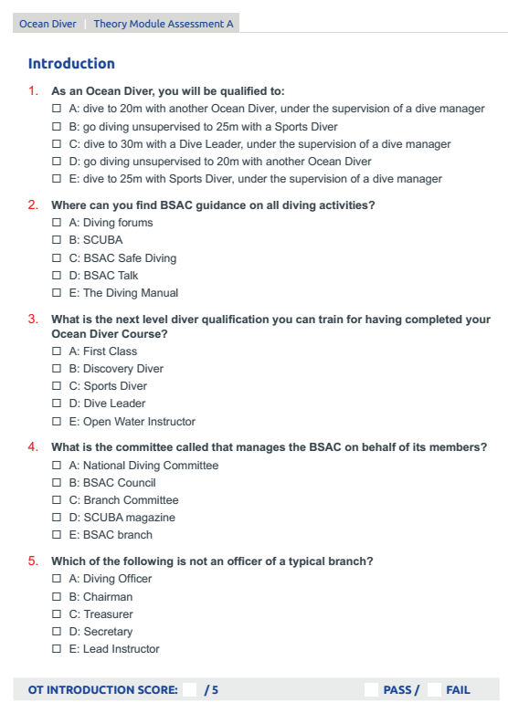
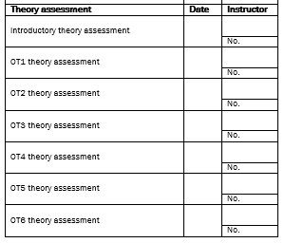
Changes to the theory exam

Slide 11
Changes to theory lessons
Slides have totally been refreshed
New Instructor manual with in depth support/information
Six theory lesson not seven
No longer info of club, this is provided separately on a sheet
More quizzes in presentation to get constant feedback
Better online teaching support
Online videos
https://www.bsac.com/page.asp?section=5259&sectionTitle=Ocean+Diver+skills+videos
Online tests
https://www.bsac.com/page.asp?section=1548&sectionTitle=Interactive+Learning

Slide 12
Online videos
https://www.bsac.com/page.asp?section=5259&sectionTitle=Ocean+Diver+skills+videos

Slide 13
Quiz 2
What are the signs and symptoms of oxygen toxicity?
Sight or hearing disturbances
Muscular twitching
Convulsions
Unconsciousness
What are the advantages of nitrox?
Reduced risk of DCI when used with air table or computer

Slide 14
Summary of changes to theory lesson
OT1 - Adapting to the underwater world
Basically old OT2 going through kit but with better sides but includes thermal protection here
OT2 - The body and the effects of diving
Have a basic understanding of respiration and circulation
Understand the need to monitor breathing gas Include using Gas Monitoring and Nitrox analysis
Understand the need for general awareness and fitness before diving
Understand what happens to air spaces in the body when diving
Have a basic understanding of the effects of nitrogen on the body when diving.
Understand that management of nitrogen is crucial to minimise the risk of decompression illness (DCI)
Have a basic understanding of breathing gas mixtures and the effect of oxygen on the body when diving
Slight re ordering

Slide 15
OT3 - Going diving
Know that diving is an adventurous sport and that risks need to be assessed and mitigated to make it as safe as possible
Understand the importance of diving as a buddy pair
Understand that diving is controlled by a Dive Manager
Understand the importance of the dive plan, briefing and buddy check
Know how to use diving signals
Know what to expect and what to consider during a dive
Have a basic understanding of the environment underwater
OT4 - Dive Planning
Know how to manage nitrogen absorption and release to minimise the risk of decompression illness (DCI)
Understand the terminology used in the BSAC decompression tables and how to use the tables to plan a single dive
Know how to plan repeat dives with no mandatory decompression stops
Know the monitoring equipment needed to dive a planned dive
Understand the basic functions of dive computers and how they can be used for dive planning and diving
Understand the fundamental differences between dive tables and dive computers and that neither tables nor dive computers are infallible
Be aware of the effects of altitude on decompression planning
Be aware of the effects of ﬂying on decompression planning
Reinforce their basic understanding of oxygen toxicity
Reinforce the need for gas planning, the use of the rule of thirds to plan gas requirements, and the need to monitor gas on dives

Slide 16
OT5 - What happens if?
Understand that anticipating problems is part of dive training and planning
Understand the importance of the early resolution of underwater problems
Be aware of the types of problem that divers may encounter
Know that oxygen administration is a first-aid tool for divers
Know that recompression treatment should be sought following any abnormalities present after a dive
Know how to effect a rescue
OT6 - Enjoying your diving
Know about the different types of dive site and diving conditions that they may experience in the future
Be aware of the different diving platforms that they may encounter
Understand the essentials of reef, wreck and night diving
Understand that reef and wreck divers carry a responsibility to protect the sites for future divers
Be able to plan for holiday diving, which may take place outside a branch or centre
Know how to progress their experience once qualified as Ocean Divers

Slide 17
Summary of the theory
Broadly similar content
More effective ordering
Better instructor manual
Better visual aids
Better supporting teaching resources
Builds confidence faster and better position of the “what ifs” and how to use equipment

Slide 18
Summary of changes in pool lessons
OS1
Snorkelling hasn't changed
Surface Scuba work hasn't changed
Emphasis on regular gas checks and use of underwater signals
Emphasis on not using hands for trim correction
Suggests breaking down buoyancy into steps, inflating/deflating BCD in small bursts during ascent and descent.
Underwater phase hasn't really changed
OS2
Introduces fill BCD by mouth within buddy check and surface scuba work
Greater emphasis on buoyancy recap
Emphasis of gas checks and signals
Controlled self lift to surface brought forward to be part of early buoyancy work
Extra steps added to mask clear in the shallows with mask strap not fitted covering remove and replace*
Normal mask clear progression follows
DV removal, location and replace follows the Ben T approach *
AS is as normal, emphasis on being positioned to see each others faces clearly*
OS3
Switch between reg and snorkel now in this lesson at the start, as prelude to deep water descent
Buoyancy work spelled out a bit more
BC inflator as before
Extra buoyancy work emphasised (mid water hover, then ascend as pair added
Recap of mask clear and breathing from free flowing reg as before
OS4
Duck Dives has gone
Now start scuba section with 25m swim breathing from snorkel, BCD partially inflated.
Have added frog kick as "alternative finning technique", to help build on buoyancy & trim work. Assessment is to maintain buoyancy and trim whilst being task loaded with alternative finning or rolls, not to perfect the technique
Rest of lesson as before
OS5
AS skill added to by adding extra progressions, in which the drill starts with pair swimming side by side, then after obtaining AS and grip continue to swim side by side for a further 10m.*
CBL added to by final progressions in which casualty and rescuer start 3m apart and the rescuer has to swim to the casualty and deal with a casualty starting face down.*

Slide 19
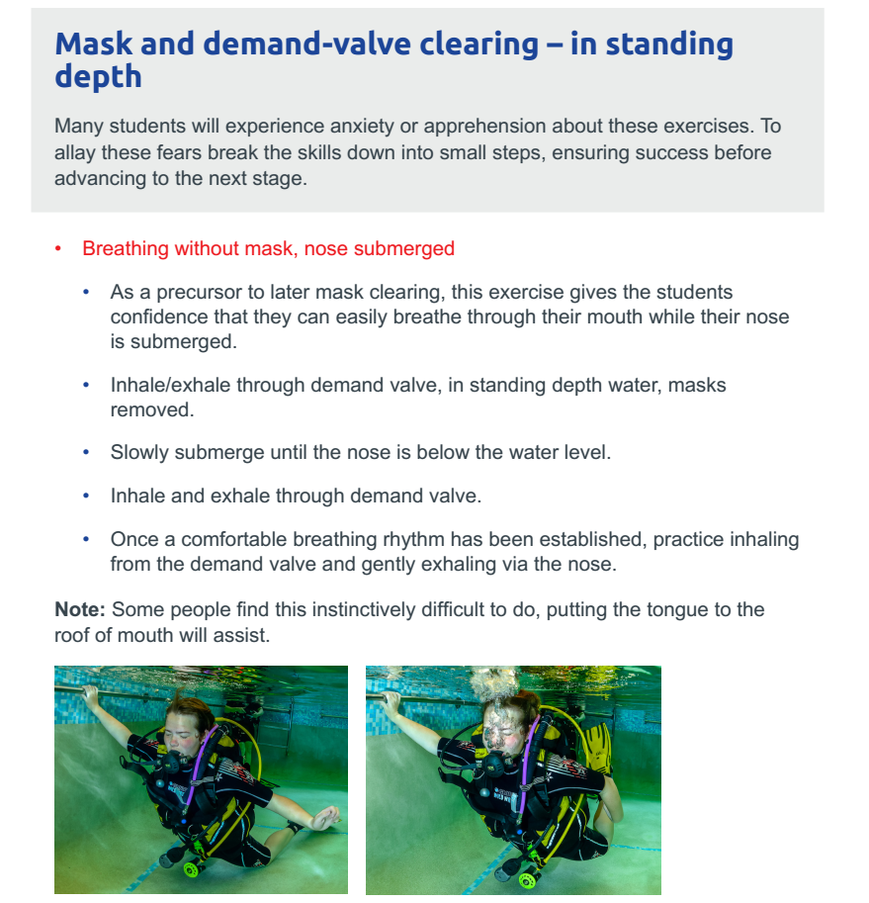

Slide 20
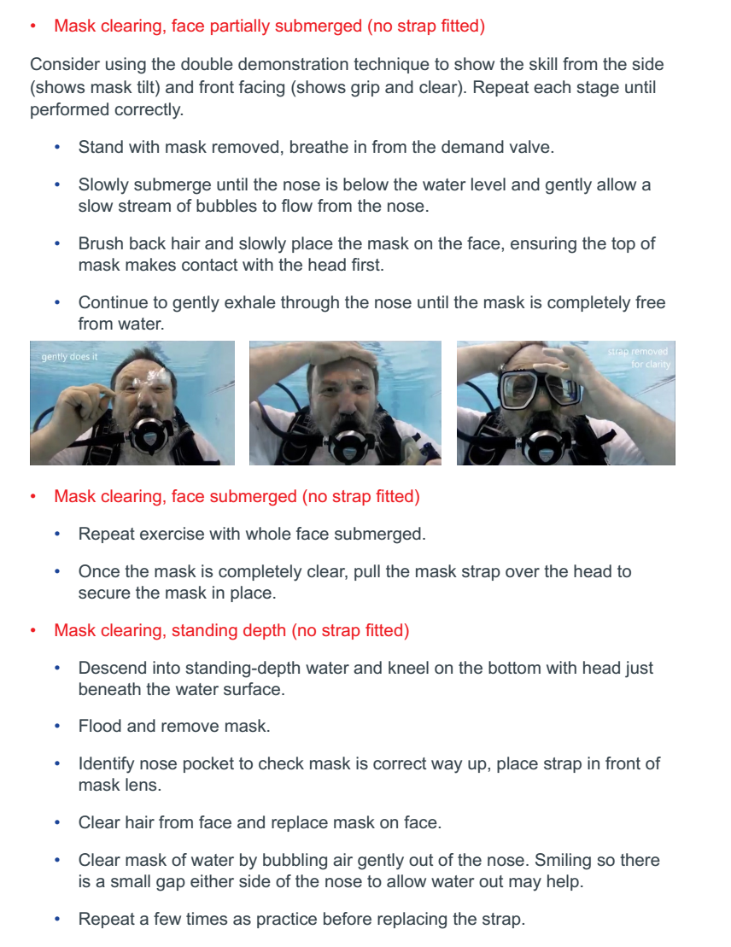

Slide 22
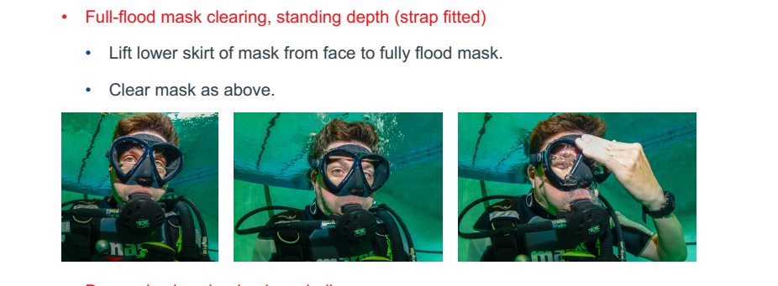

Slide 23
Full mask clear lesson OS2 - ICUC adapted version from IM Having trialled this at the pool this is the slightly more broken down for our ADI, I hope its useful
Location: In standing depth, in SCUBA kit and no fins.
Initially holding on to side remind the student of controls to BCD and get to stage were the are neutrally buoyant/able to submerge face easily. Ask which technique they prefer to spread legs or bend to be al
Initially get breathing through DV, slowly submerge to degree of only just nose underwater ( You may suggest to close their eyes when breathing out and support student via the arm)
Fully submerge and breath DV 8 breaths with out mask. (NB support student via the arm as you will be able to feel if the bolt to the surface/Therefore finding out who breathes through their nose)

Slide 24
ICUC Mask Clear
Hold mask with strap in front demonstrate palm on top of the mask (Adapt for mask and student). Clear hair from forehead, apply mask to face (no water inside). Take breath on surface breath through nose.
Initial above water, half surface submerged, then submerged. Then few repetitions. (This can be relatively quick depending on student
If student struggles add regulator to mouth
As above but apply mask under water, you may need to support the student as they wont be holding on to the.
Get the students to watch you with their mask on their face

Slide 25
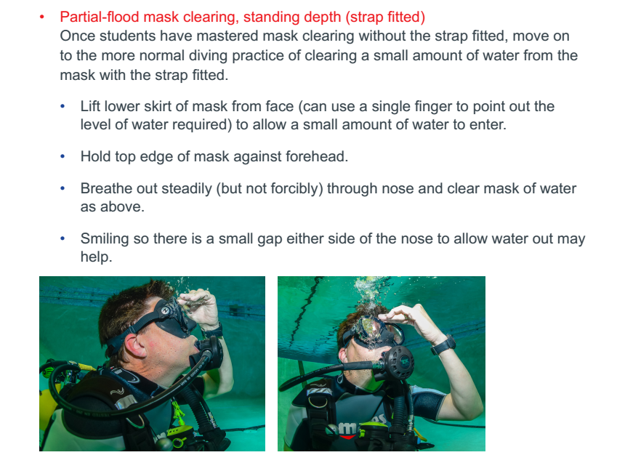
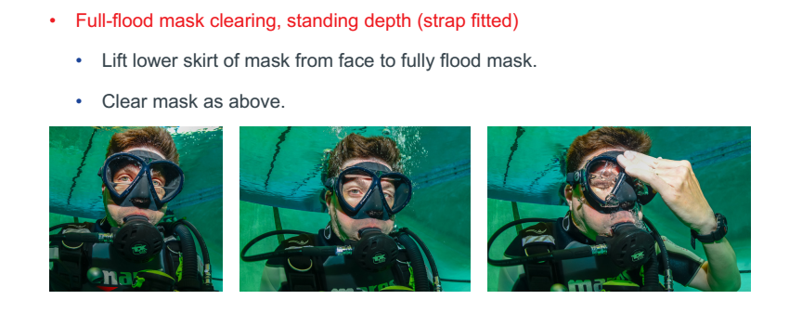
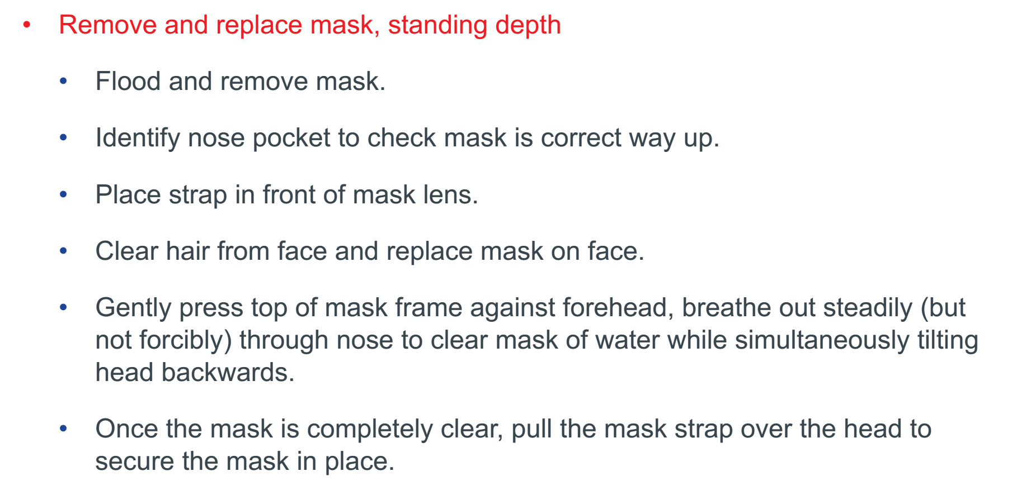
ICUC Mask Clear
Strap on and in standing depth as manual

Slide 26
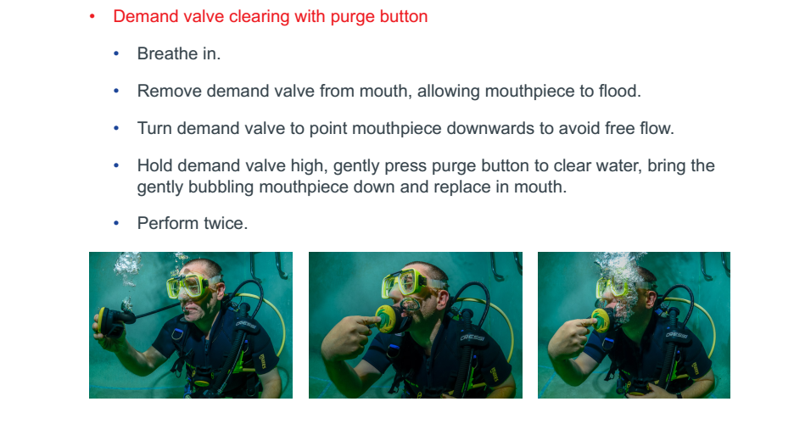
Regulator retrieval

Slide 30
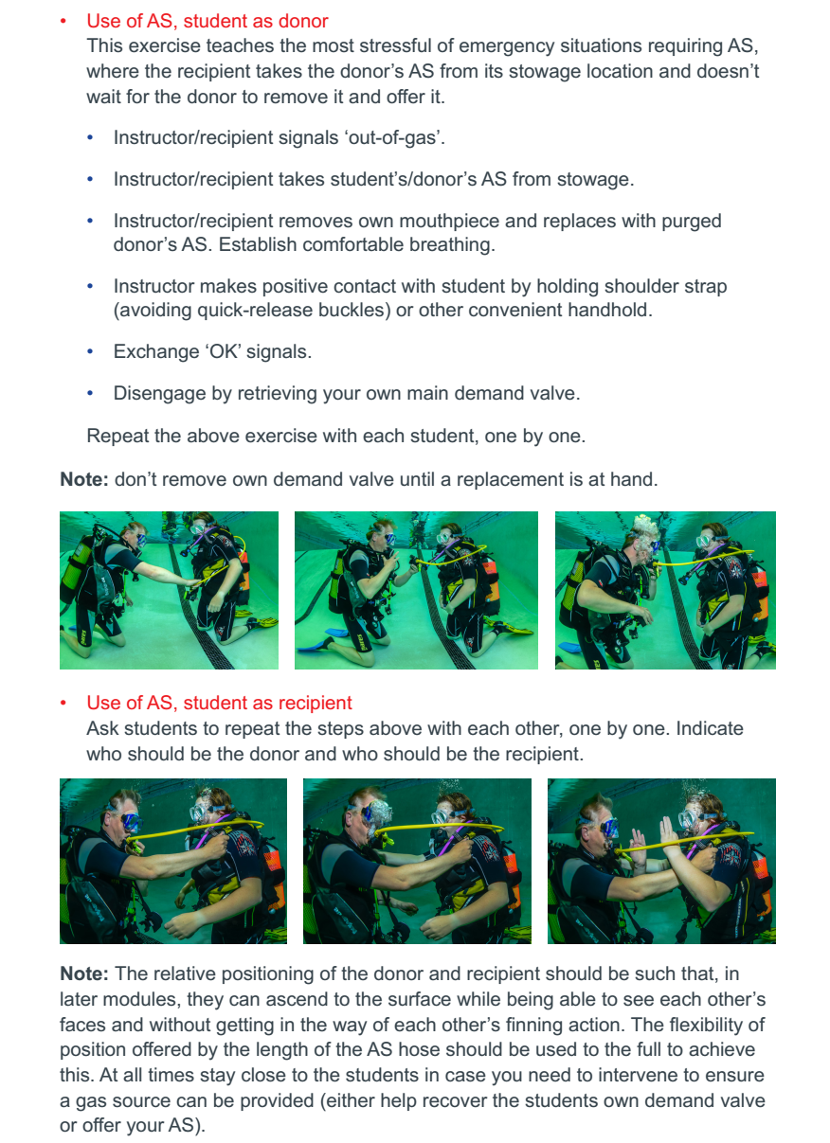
AS Lesson OS2-3
NB Donors arms should be out of the way but not above head. Particularly bad in drysuit

Slide 32
AS with swim OS5
AS skill added to by adding extra progressions, in which the drill starts with pair swimming side by side, then after obtaining AS and grip continue to swim side by side for a further 10m.*
NB positive hold not seen in photos but under shoulder strap is a great place for hld.
Also it appears from trials that the instructor being in front facing students seems to be a good position especially for nervous divers but must be adapted for location

Slide 33
CBL OS5
Same as before but added emphasised first step
NB You do not teach initial dump of your own air from BCD, you should start neutrally buoyant but still teach open up shoulder dump

Slide 34
Summary of Sheltered
A few additions to the
Extra steps added to mask clear in the shallows with mask strap not fitted covering remove and replace
DV removal, location and replace follows the Ben T approach
AS is as normal, emphasis on being positioned to see each others faces clearly
Have added frog kick as "alternative finning technique", to help build on buoyancy & trim work. Assessment is to maintain buoyancy and trim whilst being task loaded with alternative finning or rolls, not to perfect the technique
AS skill added to by adding extra progressions, in which the drill starts with pair swimming side by side, then after obtaining AS and grip continue to swim side by side for a further 10m.
CBL added to by final progressions in which casualty and rescuer start 3m apart and the rescuer has to swim to the casualty and deal with a casualty starting face down.
Notes
Check the manual its really good
Though IM is detailed, tailor it to your students and conditions

Slide 35
Open water lesson
There are now only 4 lesson but modulus (mainly for BSAC centres)
Basically taken out one extra AS
Skills as the same as pool
But specific emphasis on certain thing
NB Whilst the IM looks like its quite prescribed please tailor to your students and conditions.

Slide 36
Summary of open water skills

Slide 38
Summary of open water changes
Specific emphasis on extra steps
Emphasis on dry runs in full kit and gloves
Emphasis on Drysuit and BCD inflator stuck open
Emphasis on buoyancy, add extra steps in water, more hovers and emphasis on with changing depth
DV retrieval remember extra octo step
AS add horizontal swim
Addition of nitrox/gas analysis on kitting up OO3-4
Addition of a demonstration o extra finning techniques
NB They are now qualified to use any nitrox mix under 36% (not just 32% and 36%)
but they still have to use it as air!!!

Slide 39
Summary
A lot of work has been done to improve the course
Visual aids
Instructor Manual
Streamline and refinement of the course
Enhanced and emphasised certain progressions
Ultimately read the Instructor Manual
Tailor the course to your students
Remember your STEPS, PAVE, SEEDS REAP

Slide 40
Acknowledgements
Presentation and trialling techniques
Simon Child & Marko Jung
Imperial College Underwater Club
Oxford University Underwater Exploration Group
Course
Diver Training Programme (DTP) review
Everyone at BSAC that helped with bringing out the course

Slide 41
Thanks for your attention
Happy instructing
bsac.com facebook/britishsubaquaclub | twitter.com/bsacdivers
(0)151 350 6200 | info@bsac.com

